Slide 1
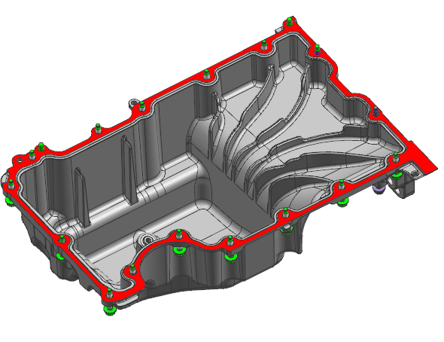
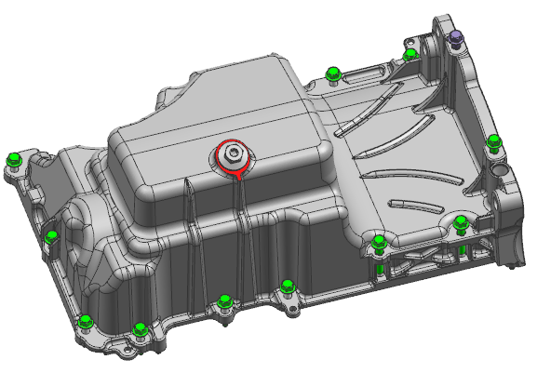
GM PAN ASM-UPR OIL
Technical Review
Part Name : PAN ASM-UPR OIL
Part No. : 25206258(ASSEMBLY)
BGH00954(MCHG)
RFQ No. : 601088175
DaeYong Industry Co.
DUNS 687885681
Oct 10, 2024

Slide 2
Contents
Contents
Introductions
Company Overview
Quality Data
Manufacturing Plan
Technical Data
Testing & Validation Plan
Timing Plan
Engineering Design & Development
Supply Chain Plan (Logistics, Packaging)
Commercial review
PAN ASM-UPR OIL
25206258(ASSEMBLY)

Slide 3
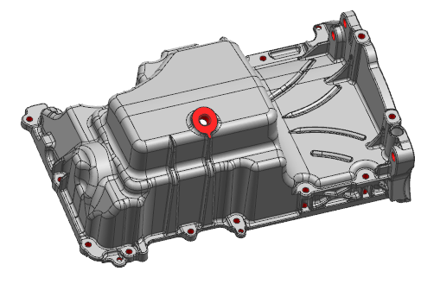
Parts Quoted
Date of Tech Review : Oct. 10. 2024
Supplier Name : DaeYong Industry Co.
Proposed Mfg. Site : MTV & Sihwa Plant, S.Korea
DUNS NO. : 687885681
RFQ NO. : 601088175
PAN-OIL
BGH00954(MCHG)
PAN ASM-UPR OIL
25206258(ASSEMBLY)
Part Number & Design Level : bgh28391.drawing001.001016
2D Drawing (MCHG : R001)
25206258.drawing001.001013
2D Drawing (ASSEMBLY : R001)
Appendix B Date & Revision: 03. June. 2024 / Rev.004

Slide 4
Ⅰ. Introductions
List of Tech Review participants
Title | Name | Phone Number | E-Mail Address
Engineering General Manager | N.K. Ryu | +82 31 500 2843 | nkryu@daeyong.co.kr
Technical Sales Sr. Manager | Chris Park | +82 31 500 2839 | kspark@daeyong.co.kr
Engineering Sr. Manager | S.B. Lee | +82 31 500 2850 | sblee@daeyong.co.kr
Engineering Manager | H.S. Kim | +82 31 500 2848 | hskim@daeyong.co.kr
Technical Sales Manager | John Kim | +82 31 500 2858 | twkim2@daeyong.co.kr
Account Manager | Matthew Kern | +1 248 227 5511 | mkern@dyc-usa.com
Sales Engineer | Jayden Chun | +1 917 806 3636 | dchun@gkasales.com

Slide 5
Ⅱ. Company Overview - Corporate structure & divisions
CEO
(Privately Owned)
TOP MANAGEMENT
IKSAN
PLANT
SIHWA
Head Quarter
VIETNAM
PLANT
PLANT DIRECTOR
FUNCTIONAL
GROUP
Manufacturing
R&D
* NBD
Sales
Admin
Finance
Manufacturing
Management
R&D 1
*NBD
Technical
Sales
HR
Accounting
R&D 2
Casting
R&D 3
Advanced development
Sales
Management
Purchasing
Machining
Production
Engineering
Inspection
Tool
Building
**S.H.E
OPERATIONAL
TEAM
Quality
*New Business Development
**Safety, Health & Environment

Slide 6
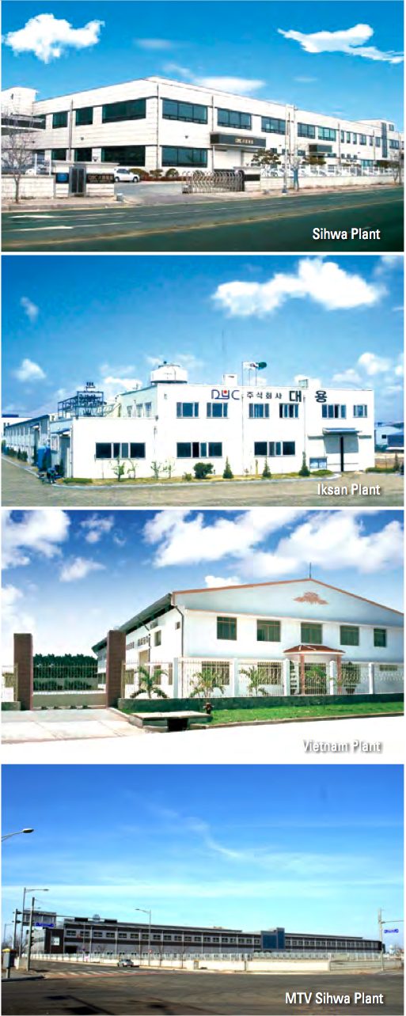

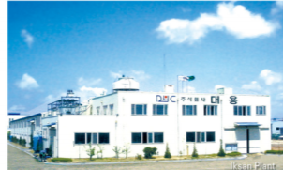
Ⅱ. Company Overview - Locations
DAEYONG Plants
SIHWA Plant (HQ)
470 employees
34,014 Square meter / 32km from Seoul
(Machining, Washing, Assembly, Final Inspection, Packing, and Shipping)
MTV Plant
Completed on Oct12,2015
52,669 Square meter / 5 min from SIHWA
(Al Die casting, Trimming, Shot Blasting)
IKSAN Plant
122 employees
30,000 Square meter / 200km from Seoul
(Al Die casting, Trimming, Shot Blasting, Machining, Washing, Assembly, Final Inspection, Packing, and Shipping)
Incheon
Seoul
SIHWA & MTV
IKSAN
Busan
Jeju

Slide 7
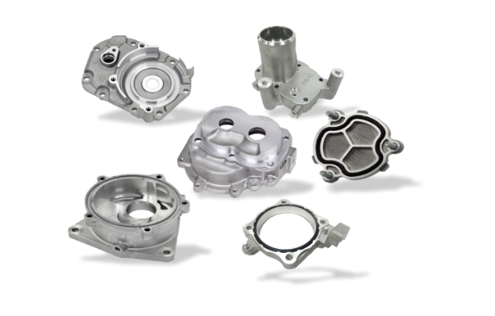

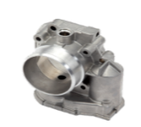
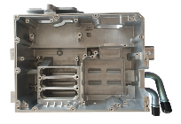
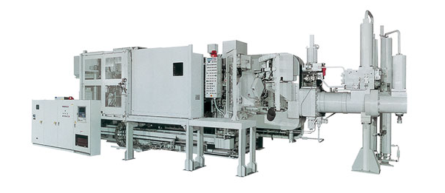
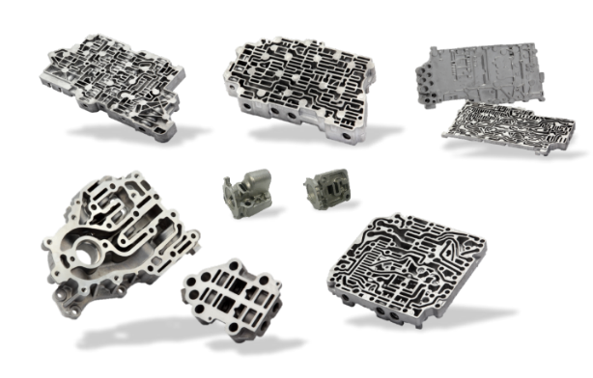

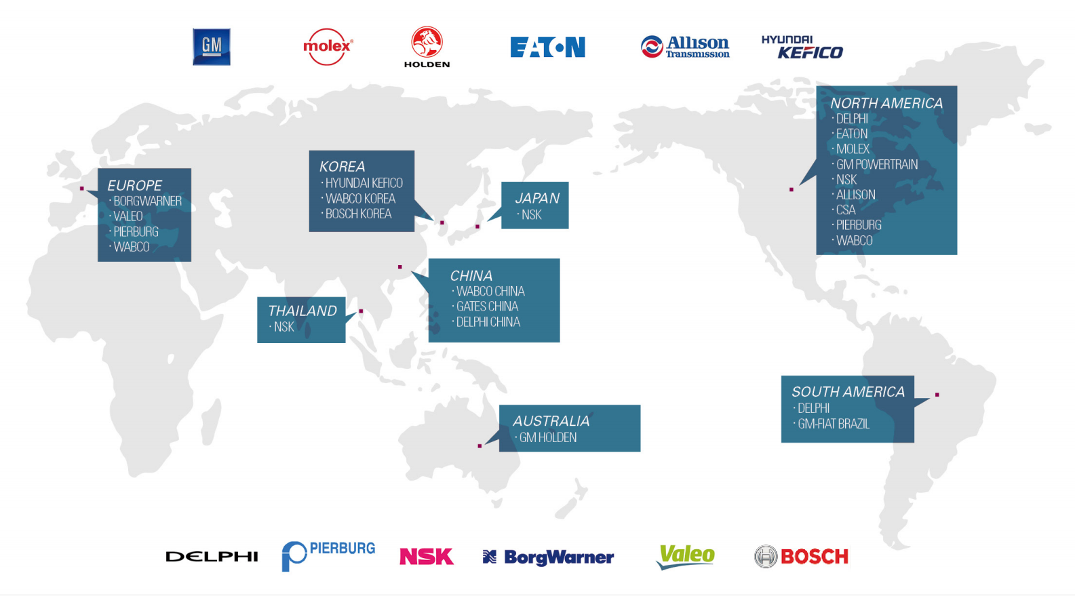

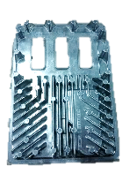

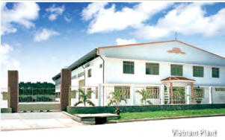


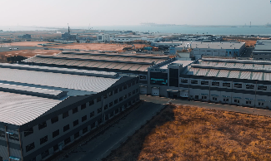



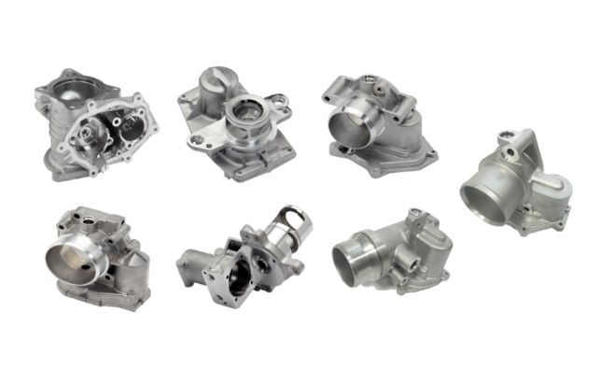
Ⅱ. Company Overview - History
1993
Start
Auto Parts
(Delphi)
1999
Iksan Plant Established
Start Biz with Eaton & Molex
2004
Start Biz with BorgWarner & NSK Steering
2020
New DCMs
1,650-ton (2 sets), 2,500-ton (1 set) setup at MTV Plant
1983
DaeYong
Established
(Lead wire)
2014
Start Biz with Hitachi USA
2023
Start Biz with
Stellantis
1992
Start Aluminum
Die Casting
(HDD to Samsung)
1996
Vietnam Plant Established
2015
Opened new MTV Plant (Sihwa)
2022
Start Biz with SLPT &KyungShin Cable
2002
Start Biz with GM
2006-2008
Start Biz with Allison, Kefico, Pierburg, & Valeo

Slide 8

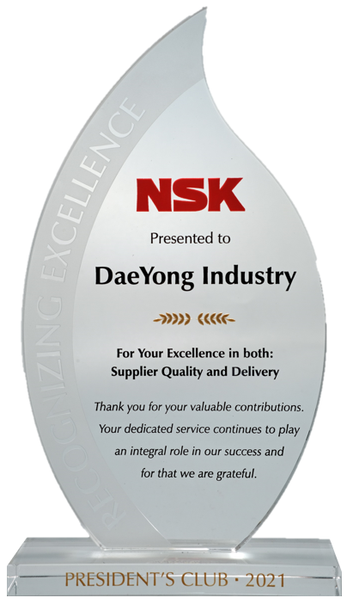
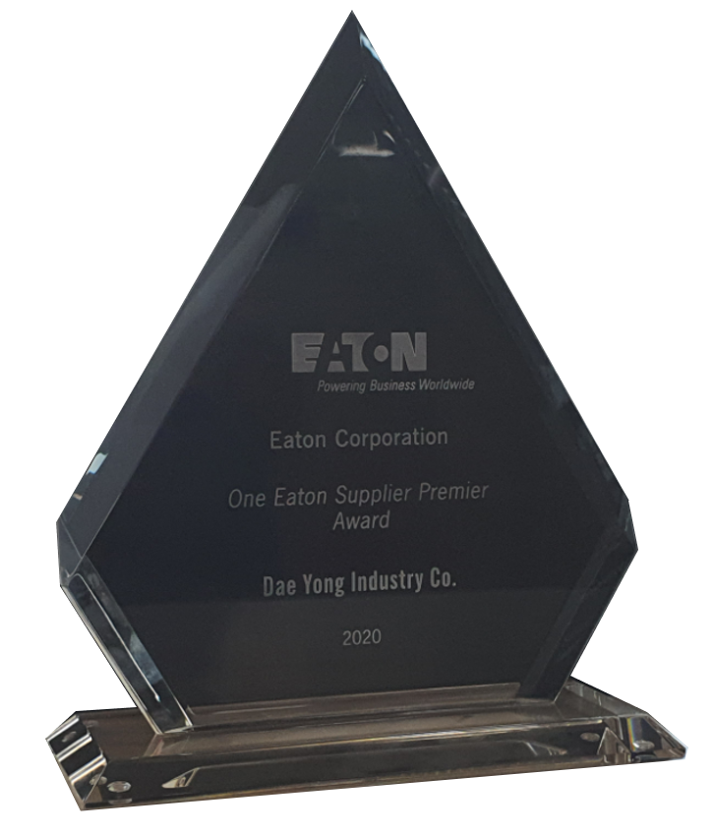
Ⅱ. Company Overview - Awards from Customers
2023
GM Supplier of the Year
2022
GM Supplier of the Year
2021
GM Supplier of the Year
NSK President’s Club
2020
EATON Premier Supplier Award
GM Supplier of the Year
2019
GM Supplier Quality Excellence Award
2018
GM Supplier Quality Excellence Award
2017
GM Supplier of the Year
GM Supplier Quality Excellence Award
2015
HITACHI Development Excellence Award
NSK Supplier of the Year
2012
EATON Supplier Excellence Award
2011
EATON Premier Supplier Award
2010
WABCO Supplier Excellence for Quality Award
2009
WABCO Premier Supplier Award
2007
BORGWARNER “Zero PPM” Accomplishment Award

Slide 9














Ⅱ. Company Overview - Global Customers
CHINA
〮 ZF Wabco China
NORTH AMERICA
〮 GM
〮 Allison
〮 BorgWarner
〮 Continental
〮 Cosworth
〮 CSA
〮 Eaton
〮 Hitachi
〮 Molex
〮 NSK Steering
〮 Pierburg
EUROPE
〮 BorgWarner
〮 Eaton
〮 Pierburg
〮 Valeo
〮 ZF Wabco
KOREA
〮 GM Korea
〮 Aptiv Korea
〮 ZF Wabco Korea
〮 Kyungshin Cable
THAILAND
〮 NSK Steering
SOUTH AMERICA
〮 GM Argentina
〮 GM Brazil
〮 ZF Wabco Brazil
AUSTRALIA
〮 Holden CCA

Slide 10
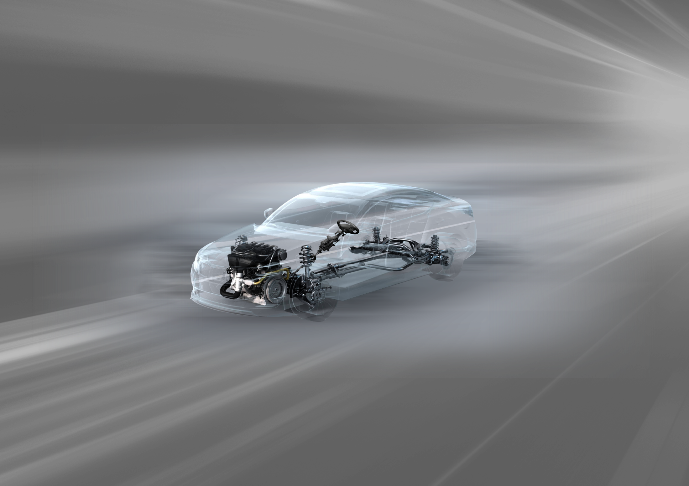
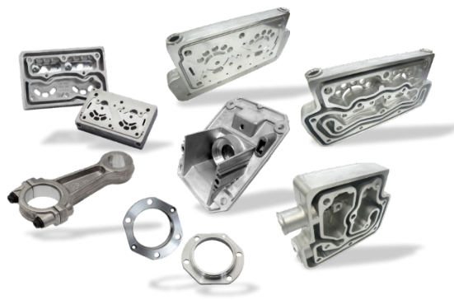
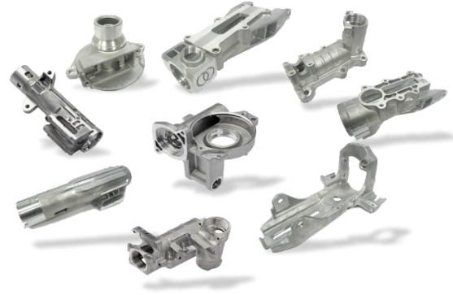
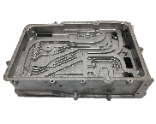
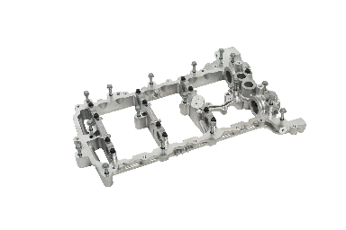
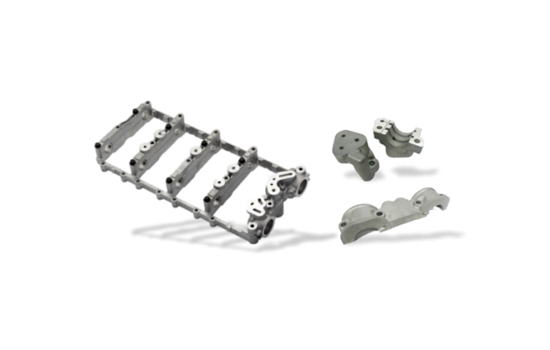




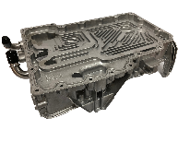


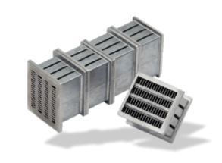
Air Compressor
EGR/ ETC ●
Steering Parts
EV Parts ●
Cam Carrier
Engine / Throttle Body /
Exhaust Gas Recirculation
Steering
Transmission
Transmission Valve Body
Super Charger / Engine parts ●
Heat Exchanger

Slide 11

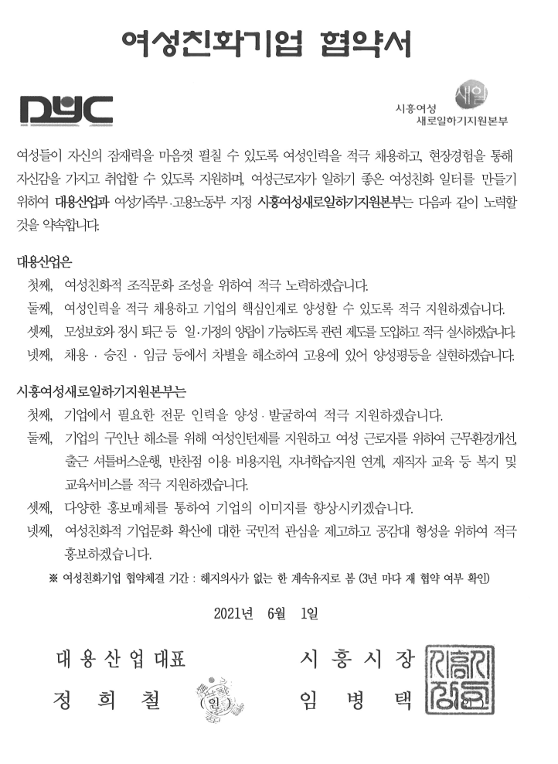
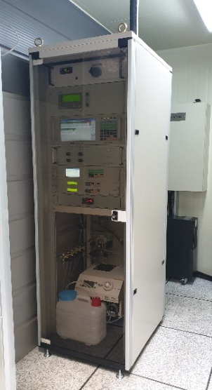
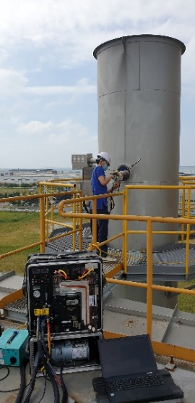

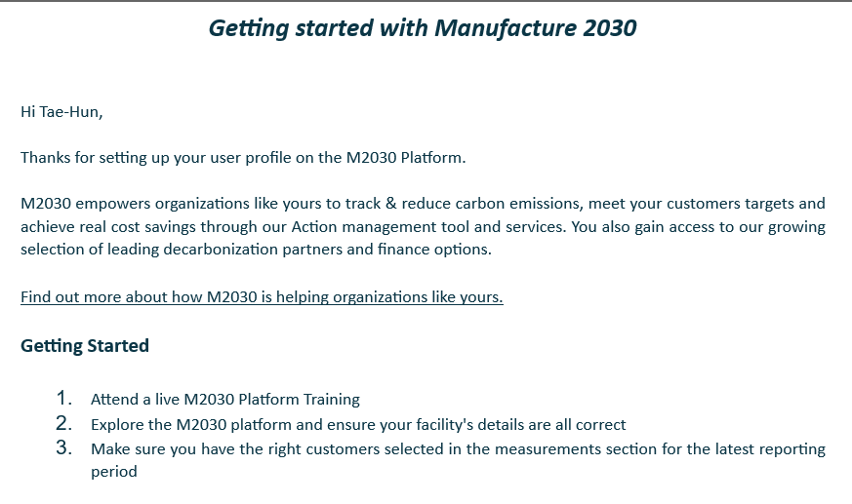
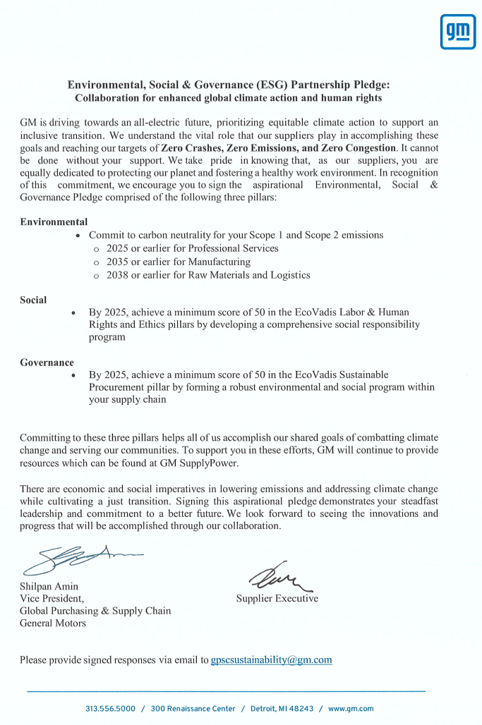
Ⅱ. Company Overview – ESG(Environment・Social・Governance)
Installed TMS equipment (chimney automation measurement monitoring equipment) on the melting facility dust collector.
Nitrogen oxide and dust discharge concentrations are being measured and analyzed every 10 seconds to keep them lower than the law regulations on atmospheric-related legal discharge concentrations.
For accurate measurement of TMS, specialized company do management for it, regularly conduct maintenance every month.
M2030 Platform
DaeYong joined the platform in April 2024.
Low carbon manufacturing Program.
Realizing gender equality through the 'Women-Friendly Company Agreement' with Siheung City(Local Government) by actively hiring women and forming a women-friendly organizational culture.
ESG pledge signed around Feb,2022

Slide 12
Ⅱ. Company Overview - Commercial Overview of Company
DaeYong Business Plan - Key Technologies and Future Strategy
High Quality Aluminum Die Casting and Machining, Complicated mold structures such as valve bodies
High vacuum casting system, weldable and improved mechanical property on casting parts (High Integrity Die Castings)
Focus on EV components such as Inverter Case / Motor Housing / Structural Parts
Invest further for larger Die casting machines(2,500 and 1,650ton) and related parts : LCE (lower crank extension), Oil pan, Engine Cover, Inverter case, EV motor case and Structural parts
Expand with additional factory in North America →US or Mexico
Additional Investment in automation
Support existing Engine and Transmission business

Slide 13
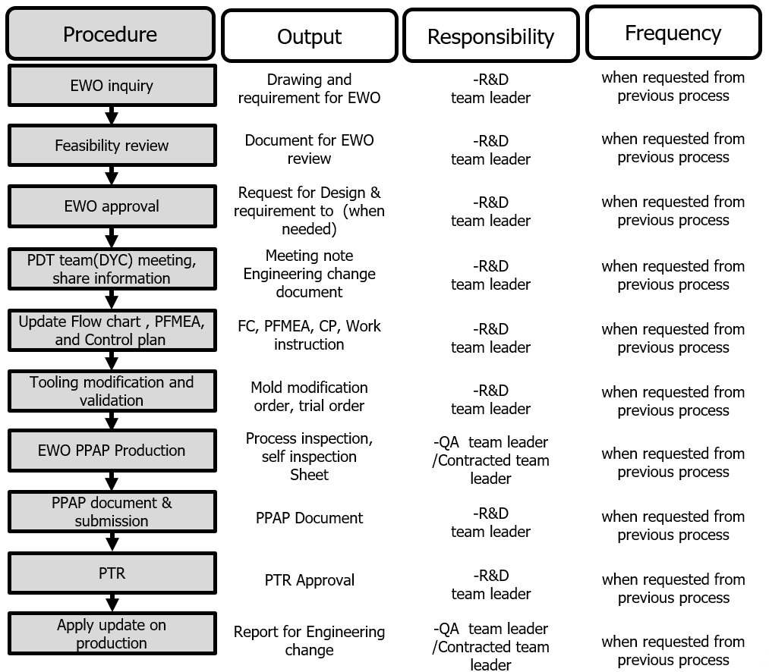
Ⅱ. Company Overview – Organizational Capabilities & Technical Capabilities
Program management and change management system
Technical Capabilities
* Currently using UG, GM Tool kit - NX 2206 platform
* Parts Development Tools: 3D Printer, CT Scan, etc.
* Functional and Developmental Testing
- Porosity measurement equipment, and software that is the same as GM uses
- Sediment, particle control

Slide 14
Ⅱ. Company Overview – Continuous Improvement
Investment in Production technology and equipment as a % of sales in 2023: About 10.65%
 | Amount | Details
Sales | $ 100M | SIHWA+IKSAN plants
Investments | $ 10,650,000 | Production technology and Equipment: $10,650,000 (10.65% of sales)

Slide 15
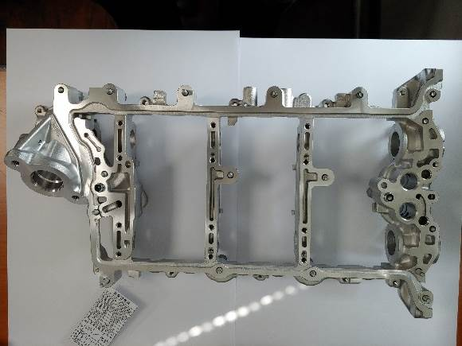
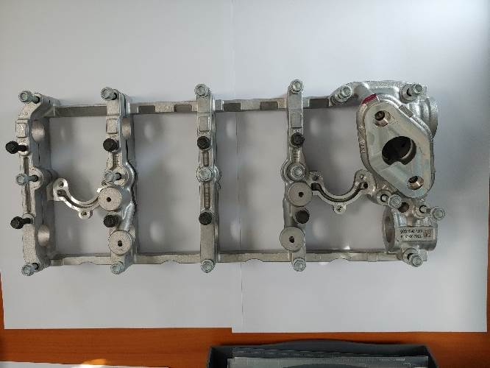
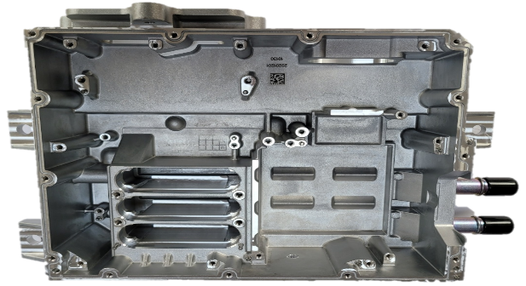
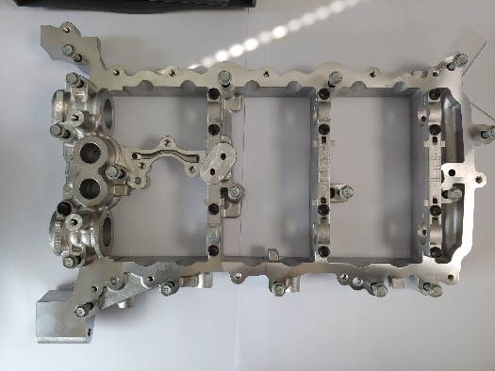
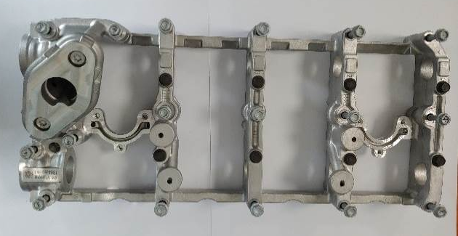
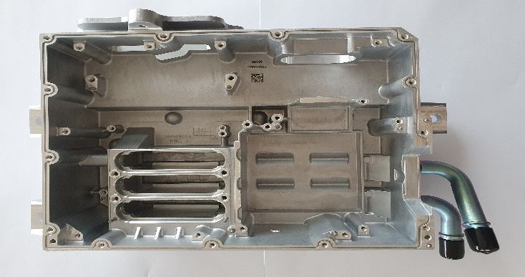
Ⅱ. Company Overview - Similar products currently producing
PN.: Part Name: | 12680230 CARRIER-CM/SHF (RH)
Material: | ALDC12
PPM: | 2023yr : 0ppm
Contracted period | Y2012 ~ 2025
PN.: Part Name: | 12694951 CARRIER-CM/SHF (LH)
Material: | ALDC12
PPM: | 2023yr : 0ppm
Contracted period | Y2017 ~ 2019
PN.: Part Name: | GD500883 CASE SUB ASSEMBLY
Material: | ALDC12
PPM: | 2023yr : 9ppm
Contracted period | Y2020 ~ 2026
PN.: Part Name: | 12680229 CARRIER-CM/SHF (LH)
Material: | ALDC12
PPM: | 2023yr : 0ppm
Contracted period | Y2012 ~ 2025
PN.: Part Name: | 12694956 CARRIER-CM/SHF (RH)
Material: | ALDC12
PPM: | 2023yr : 0ppm
Contracted period | Y2017 ~ 2019
PN.: Part Name: | GD500929 CASE SUB ASSEMBLY
Material: | ALDC12
PPM: | 2023yr : 0ppm
Contracted period | Y2020 ~ 2026

Slide 16
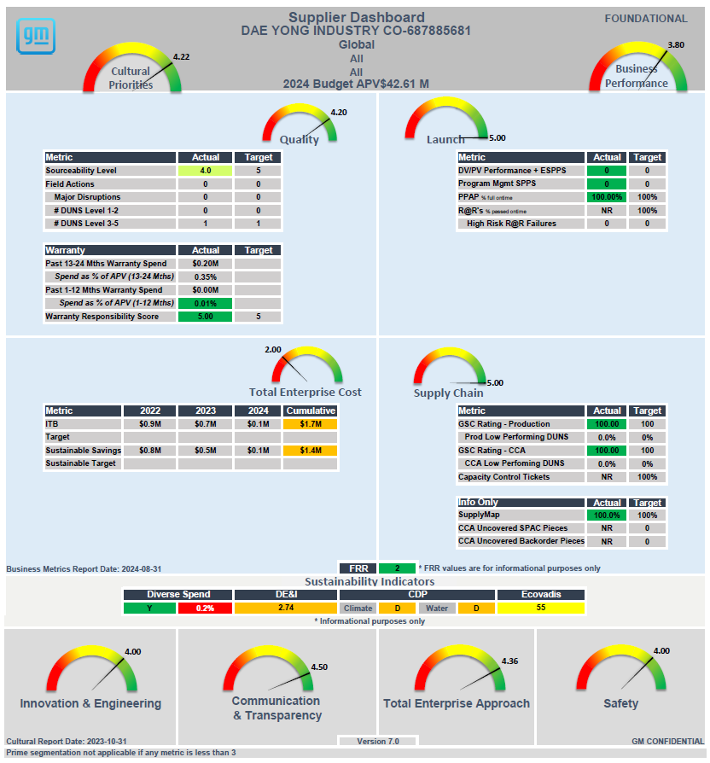
Ⅱ. Company Overview – SSE Supplier Dashboard

Slide 17
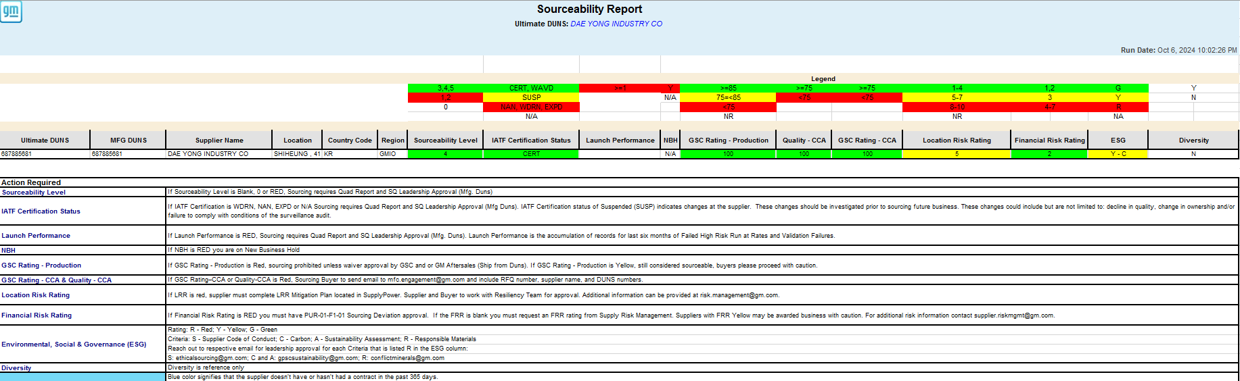
Ⅲ. Quality- Quality Metrics
  ▣ Sourceability Report Red-Yellow-Green chart status

Slide 18
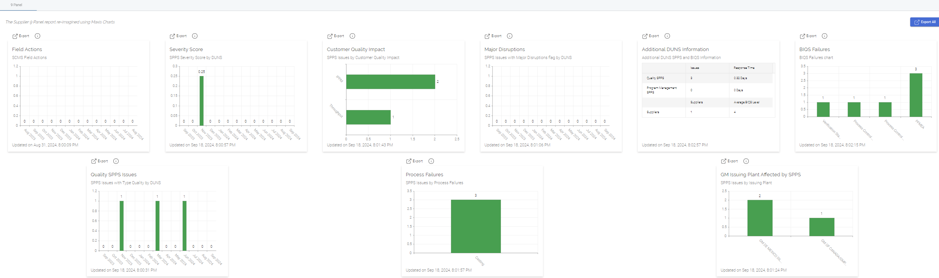
Ⅲ. Quality- Quality Metrics
  ▣ 9 – Panel Report
1) Nov. 8rd, 2023: Quality SPPS 165745
Missing material on PN#24246446.
2) Mar. 21th, 2024: Line Accumulation SPPS 179695
K-Hole Burr on PN#24047050.
3) Jun. 26th, 2024: Line Accumulation SPPS 190751
Porosity on PN#24047050.

Slide 19
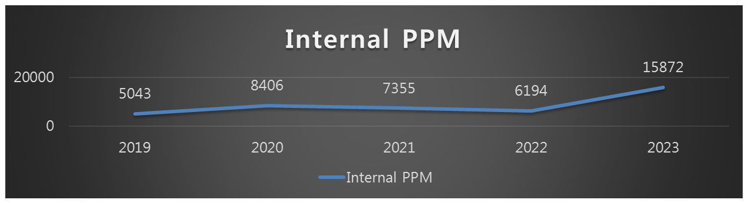
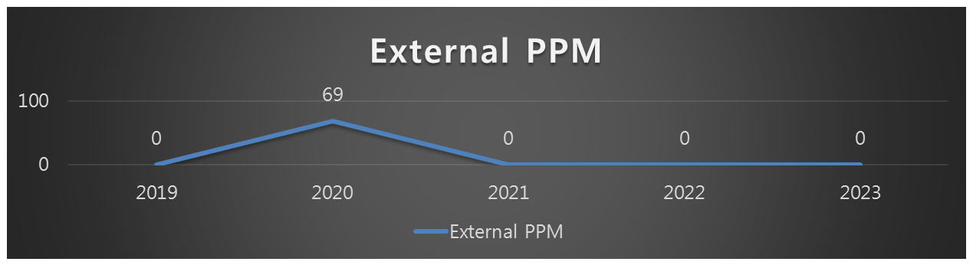
Ⅲ. Quality- Quality Metrics
  ▣ PPM internal & external per year for the last 5 year (Only for Gen2 Cam Carrier)
▣ GM Gen2 Cam Carrier Part Number: (LH Assy)12680229, (RH Assy)12680230
▣ External PPM based on Problem Case (Gen2 Cam Carrier) :
Y2020 Issue: SPPS 34758 / PN: 12680230 / Issue : Label Miss / Rejected Q’ty : 1 pallet (36pcs)

Slide 20
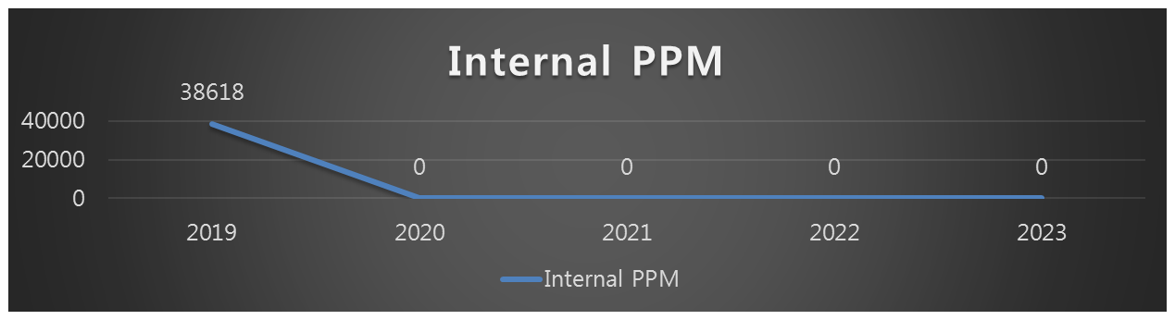
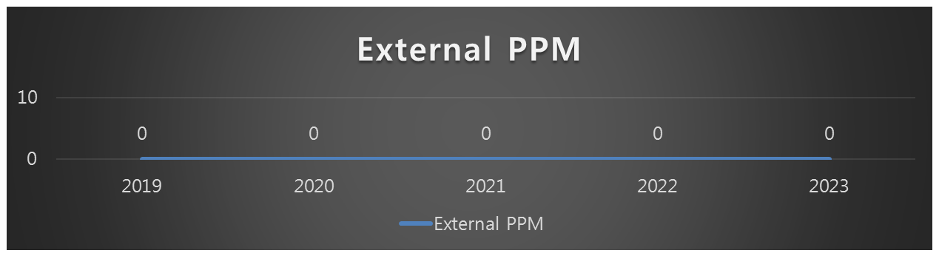
Ⅲ. Quality- Quality Metrics
  ▣ PPM internal & external per year for the last 5 year (Only for Gen6 Cam Carrier)
▣ GM Gen2 Cam Carrier Part Number: (LH Assy)12694951, (RH Assy)12694956

Slide 21
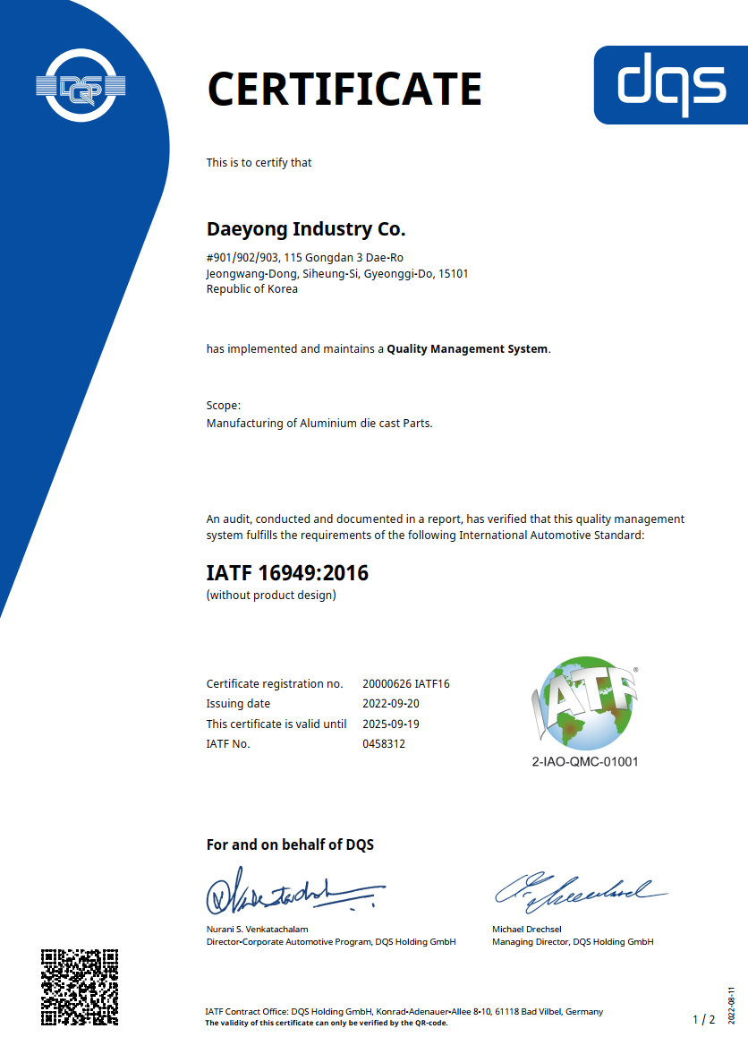
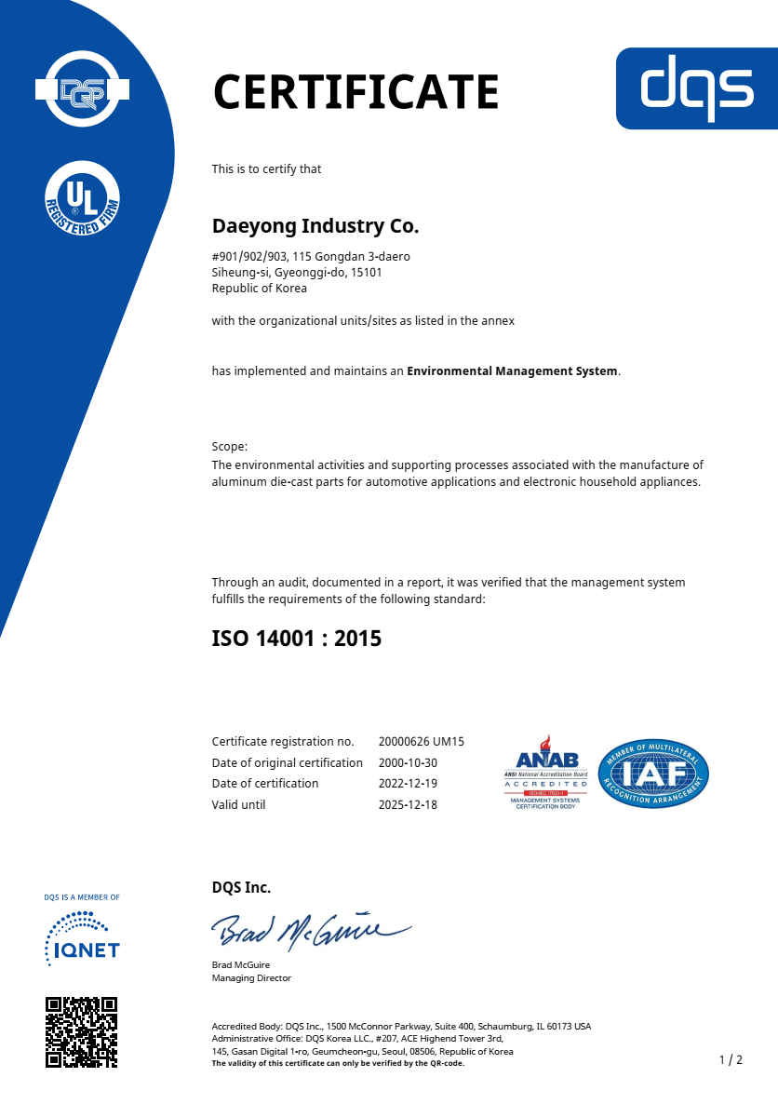
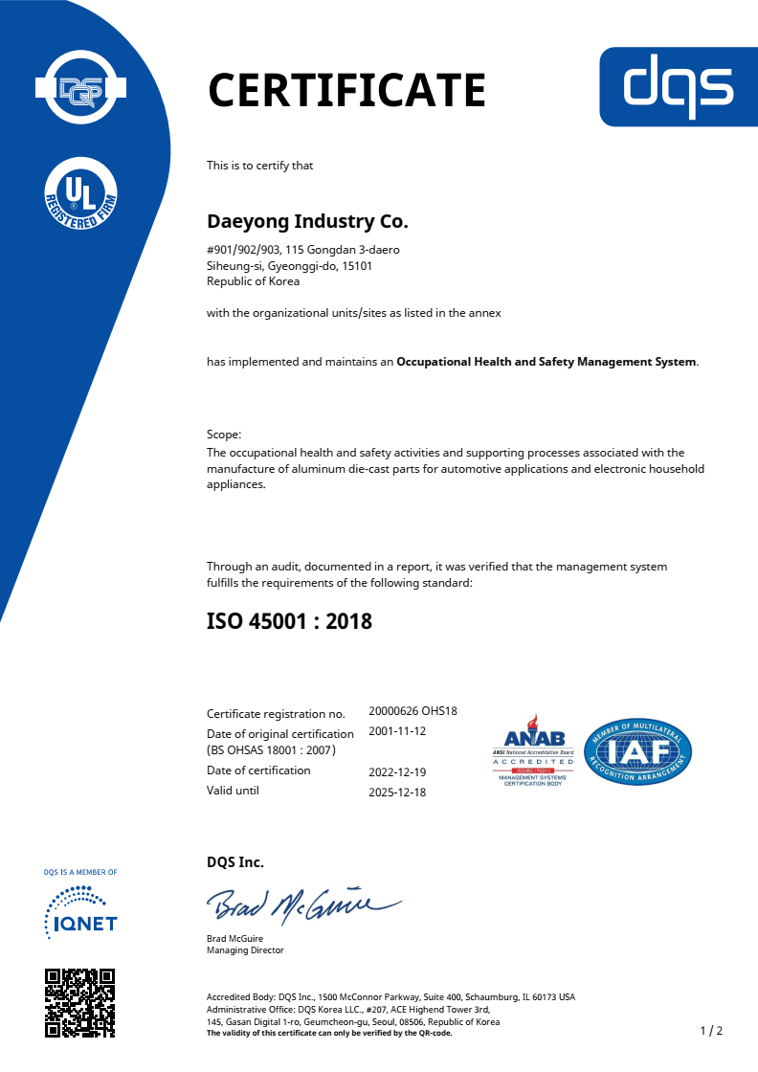
Ⅲ. Quality- Certificates
IATF 16949
(09/20/2022 ~ 09/19/2025)
ISO 14001
(12/19/2022 ~ 12/18/2025)
ISO 45001
(12/19/2022 ~ 12/18/2025)
Quality
Environment
Safety

Slide 22
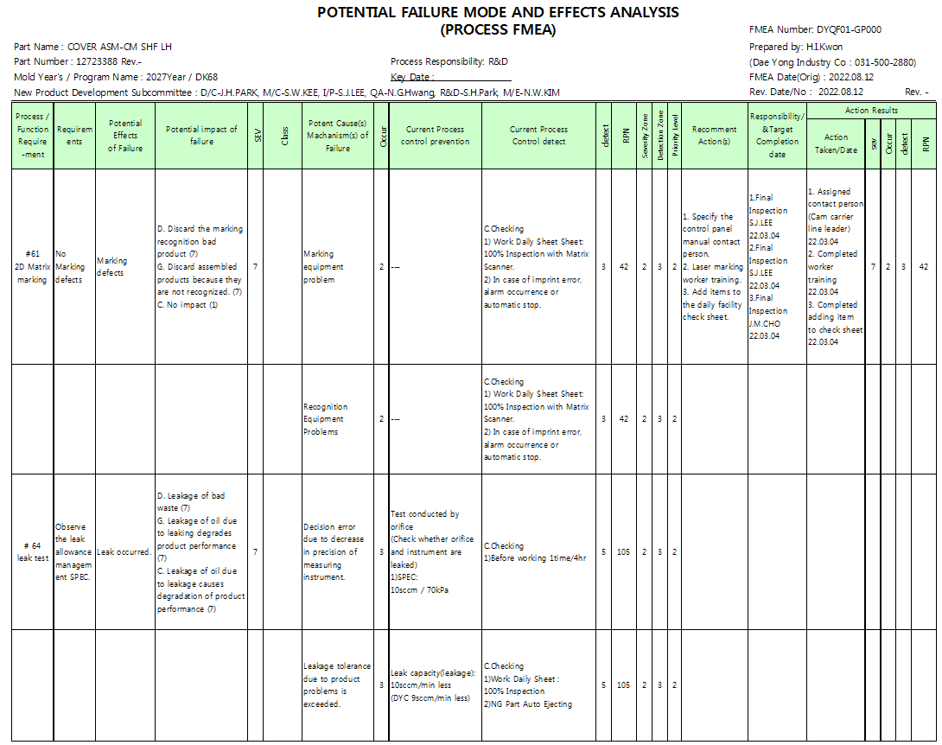
Ⅲ. Quality Data- PFMEA (Example)
EXAMPLE
22

Slide 23
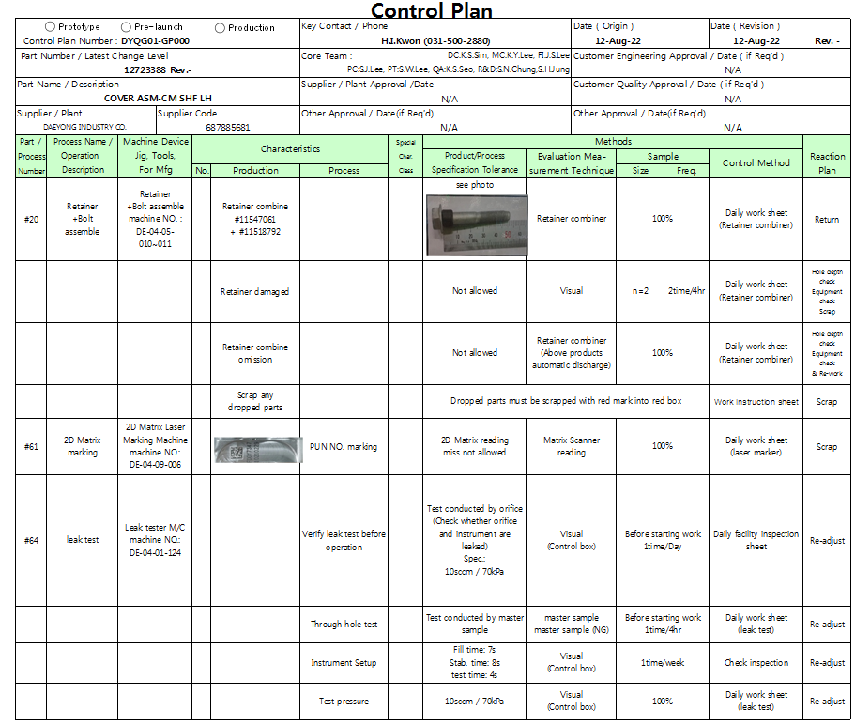
Ⅲ. Quality Data- Control Plan (Example)
EXAMPLE
23

Slide 24
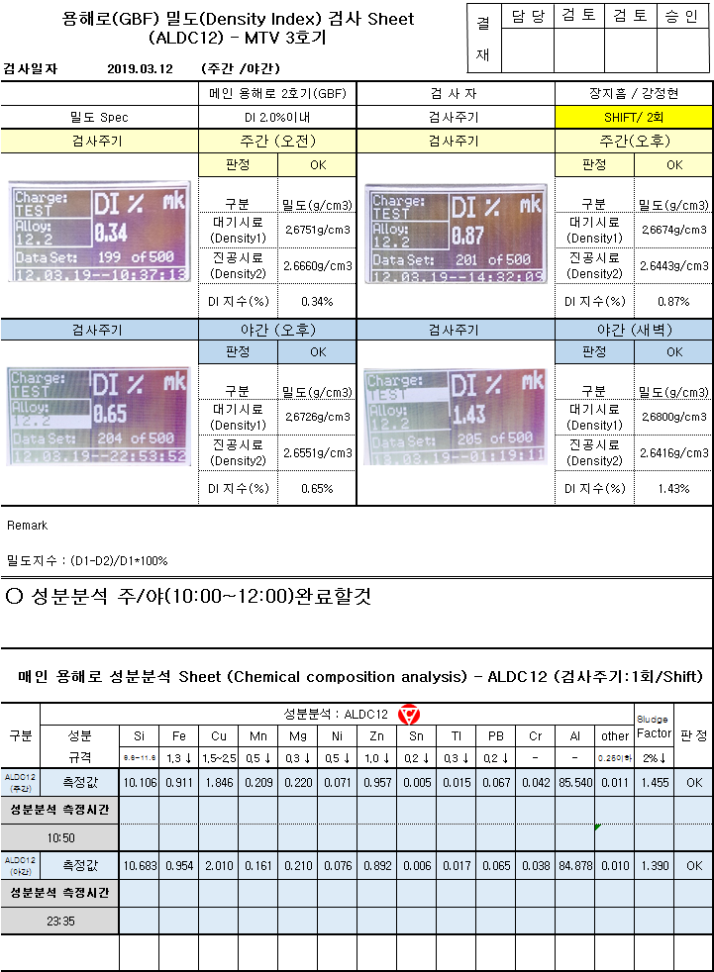



Ⅲ. Quality - Testing/Validation facilities and capabilities
Density Index
Inspector name
Frequency: 2times/Shift
Day1
Day2
The amount of gas in molten metal to be measured and managed.
Night 1
Night 2
Manufacturer : mk -GmbH
Model name : ALSP plus DT
Spectrometer
Chemical Composition Analysis to be completed during the day/night
Frequency: 1time/Shift
The components of ingot and molten metal to be analyzed and managed.
Day
Night
Manufacturer : ALDCA
Model name : KA-383

Slide 25



Ⅲ. Quality - Testing/Validation facilities and capabilities
Component Cleanliness Cabinet
(To collect particle)
Particle Measurement :
Size, Weight, Quantity
Particle Measurement Equipment
Drying
machine
Video
Microscope
system
Micro-
scope
SAMPLE
Magnifier
Micro-
balance
Manufacturer : Motic
Model name : SMZ168
X 100 scale
Manufacturer : PALL
Model name : Component Cleanliness Cabinet
Manufacturer : Sometech
Model name : SV-35 X 300 scale

Slide 26




Ⅲ. Quality - Testing/Validation facilities and capabilities
Universal Test Machine
Rockwell
Hardness Tester
Brinell
Hardness Tester
SAMPLE
-Tensile Strength
-Yield Strength
-Elongation
-3 Point Break Strength
Manufacturer : Daekyoung Tech
Model name : DTR-200
Capacity : 150kgf
Manufacturer : KSTM
Model name : K-SHB-100
Capacity : 3,000kg
Manufacturer : DaekyoungTech
Model name : DTU-900MH 10T

Slide 27




Ⅲ. Quality - Testing/Validation facilities and capabilities
CT Scanner
CT Scan Analysis Movie
SAMPLE
3D
2D
X-ray Energy: 10kV~190kV
Detector Type : Flat Panel(DDA)
Detector Size : 400 x 400 mm
Sample Weight : 227 kg max.
Focal Spot Size : 500nm min.
Manufacturer : NSI
Model name : X5000
Power : Max. 320W
For Inner porosity, Visualization analysis Movie
SAMPLE
CT Result Analysis
Before
After
-Porosity rate, Defect size, Reverse engineering rendering
-Satisfy ASTM-E2339, E2669, E2738, E2767 specifications

Slide 28



















Ⅳ. Manufacturing Plan
*The concept can be changed during developing process.
MTV
120. Packaging
& Shipping
10. Melting
Tilting Furnace
G.B.F
Density Index
115. E.P.C
Packing
Shipping
20. Die Casting
& Trimming
110. Final inspection
(Assembly check)
Final Inspection
Toshiba Diecasting Machine (automation)
Trimming
100. Assembly
BOLT SCREW, RETAINER BOLT, DOWEL PIN, ASSY ERRORPROOF VISION
30. Shot Blast
90. Leak Test
Leak Test
Shot blast Line (conveyor)
SIHWA
80. Plug, Coil Assembly
PLUG, COIL THREAD
40. Machining
Machining Center Line
Machining Fixture
70. 2D Matrix
2D Matrix
50. Washing
& Dry
60. Visual Inspection
Visual Inspection
Washing & Dry Machine

Slide 29









Ⅳ. Manufacturing Plan - Plant Layout (MTV)
*The concept can be changed during developing process.
MTV plant
Sihwa plant
MTV plant
Ref. picture of MTV plant
Process Flow (MTV Plant)
1. Ingot Incoming
5. Incoming Inspection
10. Ingot Melting
15. Degassing (G.B.F)
20. Die Casting & Trimming
30. Shot Blasting
35. Moving (MTV → Sihwa plant)
A Zone
B Zone
C Zone
MTV plant Layout (Zone “C”)
MTV plant Layout (Zone “A”)
30) Shot blast Equipment
15) Preheat & G.B.F Degassing equipment
15
10
30
20
5
35
20)Die Casting Machine : 1650 ton
1
5) Ingot inspection
Sihwa plant
1) Aluminum ingot
10) Main Furnace – Ingot Melting

Slide 30















Ⅳ. Manufacturing Plan - Plant Layout (Sihwa)
*The concept can be changed during developing process.
MTV plant
Sihwa plant
Sihwa plant
Ref. picture of Sihwa plant
Process Flow (Sihwa Plant)
35. Moving (MTV → Sihwa Plant)
40. Machining
50. Washing & Dry
60. Visual Inspection
70. 2D Matrix
80. Plug, Coil Assembly
90. Leak test
100. Dowel, Bolt, Retainer Assembly
110. Final Inspection
115. E.P.C
120. Packaging & Shipping
Inspection (3F)
Warehouse (1F)
A Zone
B Zone
Sihwa Plant Layout (1F)
Sihwa Plant Layout (3F)
Visual Inspection
Plug, Coil Assembly
Dowel, Bolt, Retainer Assembly
Packing
50
60
40
80
90
100
120
Machining Center
115
Warehouse
70
110
2D Matrix
Leak test
Final Inspection
E.P.C
Identify Area
Washing & Dry Machine
MTV plant
35

Slide 31


Ⅴ. Technical Data – Casting Concept
*The concept can be changed during developing process.
● Die Casting Equipment
Overflow
Equipment brand :SHIBAURA
Mold class: 1,650ton Die casting
Mold Material: S45C(Mold base), SKD61(Core)
Cavity
Runner
Biscuit
Mold Concept / 1 Cavity

Slide 32


Ⅴ. Technical Data – Diecasting, Flow Analysis
*The concept can be changed during developing process.
Analysis of Flow Pattern
Final filling point
32
Core
Cavity
Movie file – Click to play
Movie file – Click to play
Flow Pattern Analysis Result :
Analysis of the filling pattern shows that the filling is balanced overall.
Additional improvements could be made by changing the overflow location at the final filling point.

Slide 33





Ⅴ. Technical Data – Diecasting, Solidification
*The concept can be changed during developing process.
Solidification Analysis Movie
The patterns mean possibility to occur shrinkage, not porosity size.
Section A-A
A
B
Movie file – Click to play
Section B-B
A
B
Solidification Analysis Result :
Final solidification area is relatively thick rib area.
Even though the final solidification area is casting shape(not machined surface and machined hole), it is located close to the machined areas.
Shrinkage defect could be prevented as designing line cooling & spot cooling properly.
Shrinkage Analysis Result :
Final solidification area is same as shrinkage
Shrinkage defect could be prevented as designing line cooling & spot cooling properly.

Slide 34



Ⅴ. Technical Data – Machining Concept
*The concept can be changed during developing process.
Machining OP.#10,#20 Fixture Concept
3 Clamps & 3 Pads (2 Pins)
(OP#10 Part holding View)
Equipment brand : Brother
Equipment model : W1000Xd1
Equipment size : 2,967 x 2,410 x 2,532 (mm)
Circular : 2 axes
Helical/conical : 3 axes（X,Y,Z)
3 Clamps & 3 Pads (2 Pins)
(OP#20 Part holding View)

Slide 35







V. Technical Data – Machining Concept
*The concept can be changed during developing process.
#10 machining Process
Including Index turns to be original : 3 times / Turning operation is marked with green box
#10-4
Ø6.5 Inner Dia.(Datum Y)
#10-1,2(Roughening, Finishing)
#10-3 Brushing
Datum A(Face Milling)
#10-7
Ø8 Inner Dia. 14x
#10-5 Ø5 Inner Dia.
#10-6 Ø5.95 Inner Dia.
(Datum B.C)
#11-1 Face Milling
#11-2,3 M12 Tap Drill, Tap Machining
#10-8
Ø8 Inner Dia. 4x
#10-9
Side Machining
(Gates Remove)
OP#11
Index turn
OP#12
Index turn
#12-1 Ø8 Inner Dia. 2x

Slide 36


V. Technical Data – Machining Concept
*The concept can be changed during developing process.
#20 machining Process
#20-1,2(Roughening, Finishing)
#20-3 Brushing (Datum F) (Face Milling)
#20-4
Ø11.9 Inner Dia.
#20-5
Ø11.85 Inner Dia. 2x

Slide 37











Ⅵ. Manufacturing Plan – Automation Assembly Detail
Appendix C BOM
DaeYong purchased components (No 1~8)
1
2
3
4
11589108
(x12)
11562025 (x1)
BGH31732
(x1)
11588719
(x2)
5
6
7
8
11518792
(x16)
3525915
(x2)
55577568
(x1)
11503302
(x1)

Slide 38







Ⅵ. Manufacturing Plan – Automation Assembly Detail
1 |  | 11589108 | BOLT-HVY HEX ACORN FLG HD
2 |  | 11562025 | BOLT / SCREW
3 |  | BGH31732 | BOLT / SCREW
QTY: 12
QTY: 1
QTY: 1
4 |  | 11588719 | BOLT / SCREW
5 | 7 | 11518792 | RETAINER – M6 BOLT
6 |  | 3525915 | PIN-DOWEL
QTY: 2
QTY: 16
QTY: 2

Slide 39


Ⅵ. Manufacturing Plan – Automation Assembly Detail
7 |  | 55577568 | PLUG ASM-ENG OIL DRN
8 |  | 11503302 | INSERT-METRIC COILED THREAD
QTY: 1
QTY: 1

Slide 40
















Ⅵ. Manufacturing Plan – Automation Assembly Detail
*The concept can be changed during developing process.
70. 2D Matrix Marking
101. Bolt Press fit
X1
X14
X1
X2
70
81
90
100
101
Asm check
Start
80
110
110.Assembly Check
missing ASM and
incorrect ASM
80. Coil-Thread
81. Plug
90. Leak Tesk
100. Dowel Pin press
X1
X1
SPEC : 10cc/min @ 70 ±3 kPa
X2

Slide 41

Ⅶ. Timing Plan – APQP Timing Chart

Slide 42
Ⅶ. Timing Plan – Lead Time Detail - Gamma(PTB) Sample
*The concept can be changed during developing process.
Gamma Lead Time
No. | Description | Lead Time | Remark
1 | Tooling & Equipment | 16 weeks | Die-casting: In house Dimension check: By CMM The Lead time is from receipt of PO with 2D&3D. The date is negotiable with program timing. Quantity and lead time subject to change upon quotation update. Gamma(PTB) stage sample will be arranged based on 60 pcs according to the SOR appendix B. and bolt, retainer, coil, plug will be assembled manually.
2 | Tooling Verification | +8 weeks
3 | Gamma Production | +2 weeks
4 | Gamma Sample (shipping) | D+26 weeks
Gamma Tooling Lead Time Detail (all tooling can be used for production)
PAN ASM-UPR OIL 25206258
Tooling | Lead Time | Quantity (set)
Die-Cast Mold | 16 weeks | 1
Trimming Jig | 16 weeks | 1
Machining Center (#10,20) | 16 weeks | 2
Leak Tester | 16 weeks | 1
Dowel Pin press | 16 weeks | 1
Gamma Tooling Total | 16 weeks | 6
(Reference)Appendix B Gamma MRD Schedule
: Gamma MRD : 15Jul25

Slide 43
Ⅵ. Testing & Validation Plan – Appendix G (1)
*The concept can be changed during developing process.
SOR Appendix G – Validation Cross Reference Index
GM Feedback applied after Tech review
No. | Title | Evaluation Description | Notes | Type | Method | Qty | Duration Days | DYC Comment
1 | Mold Flow and Solidification Analysis | Meets Supplier Requirements | Cast Aluminum or Plastic Pan Only | D | Casting Simulation Analysis | When it is needed |  | AnyCasting Program used
2 | Drain Plug- Over Torque Testing at 20 and 100°C | Torque to Failure - Must break or strip drain plug first | Test with oil on the drain plug interface | PV | Visual Inspection | 3 set | 1 time/Day
3 | Drain Plug- Insertion/ Removal Testing (40 cycles) | Must not break pan or strip threads and pass leak test | Test with oil on the drain plug interface | PV | Visual Inspection | 3 set | 1 time/Day
4 | Threaded Plug - Over Torque Testing | >1.5 x Nominal Torque | If applicable | PV | Torque at Breaking (Nm) | 3 set | 1 time/Day | Check whether it is tested with Drain Plug
5 | Impact Resistance - Ball Drop Testing | 63.5 mm DIA, 1.05 kg Ball 2.0 m height Must not leak water (2.0 L) | Must test at least 4 locations including drain plug location. | PV | Visual Inspection | 1 set | 1 time/Day
6 | Hot Soak Test- Engine Oil at 150°C | Must not leak through casting (using florescent dye and black light) | Cast Aluminum Pan Only. Soak Pan filled with oil at 150°C for 24 hours. | PV | Visual Inspection | 3 set | 1 time/Day
7 | 100% Leak Test- Max Leak Rate Under Pressure | Cast Aluminum: 5 SCCM MAX @ 50 kPa |  | PV | Air Leak Rate Measurement (SCCM) | When it is needed |  | Leak test concept needs to be confirmed
Not required for production.
Only for the initial PPAP
Not required for production.
Only for the initial PPAP
Not required
Not required for production.
Only for the initial PPAP
Not required for production.
Only for the initial PPAP
100% check for production(Auto line)
This List is from SOR Appendix G document, and the purpose is to check with GM
The reliability test items and testing numbers affect the piece price. It is necessary to discuss the items and quantities that can be simplified.

Slide 44
Ⅵ. Testing & Validation Plan – Appendix G (2)
*The concept can be changed during developing process.
SOR Appendix G – Validation Cross Reference Index
No. | Title | Evaluation Description | Notes | Type | Method | Qty | Duration Days | DYC Comment
8 | X-ray and Sectioning of Cast Parts | Meets Porosity Requirements | Cast Aluminum Pan Only | PV | Visual Inspection | 3 set | 1 time/Day | Need to check the cutting position
9 | Metallurgical Evaluation of Material | Meets Material Specification Requirements | Cast Aluminum Pan Only | PV | Visual Inspection | 3 set | 1 time/Day
10 | Visual Porosity Standards (Limit / Boundary Samples) | Meets Material Specification Requirements | Cast Aluminum Pan Only | PV | Visual Inspection | 1 set | 1 time/Day
11 | Water Dunk Testing- Audit | Cast Aluminum: No bubbles @ 100 kPa |  | PV | Visual Inspection | 1 set | 1 time/Day
12 | Cleanliness Measurement- Max Weight Only | Cast Aluminum Assembly: 15 mg MAX |  | PV | Measurement (mg) | 10 set | 1 time/Day* | a,Qty check required. b.Spec check c.Cleaness spec needs to be discussed
13 | RTV Adhesion Testing (after surface finish treatment) | GMUTS ≥ 8 (Standard: GMW17696) | Supplier must complete if applying RTV themselves (2 piece oil pans), otherwise this is done at the engine plant | PV | Visual Inspection | 1 set | 1 time/Week | Whether GM provides RTV for testing Whether Plasma Ashing Treatment is needed
Inspection for production
Inspection for production
Inspection for production
100% inspection for all parts prior to initial PPAP, not for production
Inspection for production
Inspection for production
Plasma treatment is done at GM facility
To do RTV, ultrasonic will be considered
This List is from SOR Appendix G document, and the purpose is to check with GM
The reliability test items and testing numbers affect the piece price. It is necessary to discuss the items and quantities that can be simplified.

Slide 45









Ⅵ. Testing & Validation Plan – Testing Detail(1)
*The concept can be changed during developing process.
1.Mold Flow and
Solidification Analysis
Quantity: Development stage, when it is needed
Frequency: Development stage, when it is needed
Any casting Program
Casting simulation
Analysis of flow pattern & solidification
2. Drain Plug-
Over Torque Testing at 20 and 100°C
100℃
Quantity: n=3 x 3 molds → 9set
Frequency: 1 time / day
20℃
Tapped holes & Plugs Damage check
Room Temp 20℃ Sample preparation
Heat the sample reaching to 100℃
Torque check

Slide 46




Ⅵ. Testing & Validation Plan – Testing Detail(2)
*The concept can be changed during developing process.
3. Drain Plug-
Insertion/ Removal Testing (40 cycles)
Quantity: n=3 x 3 molds → 9set
Frequency: 1 time / day
X1
Plug Bolt (M12 : 1pc)
Leak Test
Sample
Prepare
Tapped holes & Plugs Damage check
Assemble, disassemble
40 times repeat
4.Threaded Plug –
Over Torque Testing
Quantity: n=3 x 3 molds → 9set
Frequency: 1 time / day
X1
Plug Bolt (M12 : 1pc)
Tapped holes & Plugs Damage check
Rotate until the point of tapped hole and plug breakage
To check Torque value
Assembly Torque x 1.5times turning

Slide 47











Ⅵ. Testing & Validation Plan – Testing Detail(3)
*The concept can be changed during developing process.
5. Impact Resistance - Ball Drop Testing
Quantity: n=1 x 3 molds → 3set
Frequency: 1 time / day
Drop a Ø6.35 (1.05kg) steel ball into a 2m pipe and give a shock to parts.
Must test at least 4 points including drain plug location(Points needs to be discussed)
Check the impact location
Assembled part preparation
Fill the sample with 2L of water and check for leaks
6. Hot Soak Test-
Engine Oil at 150°C
150℃
Take out the sample and drain the engine oil
Fill engine oil + fluorescent dye in parts and heat it up to 150℃ in an oven
Check fluorescent dye penetration using a black light

Slide 48





Ⅵ. Testing & Validation Plan – Testing Detail(4)
*The concept can be changed during developing process.
8. X-ray and Sectioning of Cast Parts
Quantity: n=3 x 3 molds → 9set
Frequency: 1 time / day
SAMPLE
SAMPLE
Cutting area needs to be discussed.
Internal porosity area & specifications need to be confirmed
SAMPLE
SAMPLE
11. Water Dunk Testing
Quantity: n=3 x 3 molds → 9set
Frequency: 1 time / day
Injecting air at 100 kPa pressure to check whether bubbles are generated
Place the assembled part holding with the water dunk jig

Slide 49










Ⅵ. Testing & Validation Plan – Testing Detail(5)
*The concept can be changed during developing process.
12. Cleanliness Measurement-
Max Weight Only
Quantity: n=10 x 3 molds → 30set
Frequency: 1 time / day
Assembled part sample
Preparation
Particles(Debris) Collection
Check the weight difference before and after using the filter
Filter Dry
13. RTV Adhesion Testing
(after surface finish treatment)
Applying Provided RTV on
Surface of the sample
1mm x 1mm
height and width
Quantity: n=1 x 3 molds → 3set
Frequency: 1 time / Week
Checking the adhesion grade after taking the RTV off
(Referring to GMW17696 standard)
Surface treated sample preparation
RTV Hardening (7 Days)

Slide 50



Ⅷ. Engineering Design and Development - Open issue 1
1. Aluminum Material Discussion
#25206257 (machining) 2D : GMW5M-AL-C-D-Si10Cu2Fe-F
Similar part’s material
Appendix_C :
Material info
GMW5M-AL-C-D-Si10Cu2Fe-F is shown on 2D drawing note & SOR appendix C.
DaeYong’d like to propose changing ALDC12 or to add some additional comments like the box above.

Slide 51



Ⅷ. Engineering Design and Development - Open issue 2
2. 2D Drawing(MCHG)
Discrepancy found between 2D dwg and 3D model
5501, 6601 – No 3D provided
501, 502 – No 3D provided
611 ~ 622 – No 3D provided

Slide 52


Ⅷ. Engineering Design and Development - Open issue 3
3. 2D Drawing(ASSY)
Discrepancy found between 2D dwg and 3D model
“03” duplicate marking in 2D,
Components not shown in 3D model

Slide 53

Ⅷ. Engineering Design and Development - Open issue 4
4. 2D Drawing(ASSY)
2D Drawing BOM
Appendix C BOM
Discrepancy found between 2D dwg and SOR appendix C BOM List
#2025 qty
#9108 qty
#1732 qty
#7568, 3302 missing
3D model matches SOR appendix C

Slide 54

Ⅷ. Engineering Design and Development - Open issue 5
5. SHOT BLASTING
Shot blasting seems not allowed.
DaeYong would like to double check if it is okay to apply.

Slide 55


Ⅷ. Engineering Design and Development - Open issue 6
6. 3D model proposal
Final solidification area, shape change proposal(mass removed)

Slide 56


Ⅸ. Supply Chain Plan (Logistics, Packaging)
*The concept can be changed during developing process.
PAN ASM-UPR OIL 25206258 Packaging Concept
Packaging standard number :
1320B2 1320mm x 1140mm x 600mm
- STD pack : 24pcs / Pallet
Packing method could be discussed considering workability

Slide 57

Ⅺ. Commercial review
Wrap up!

