Slide 1
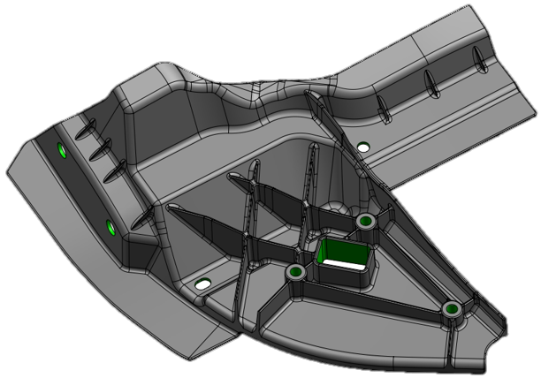
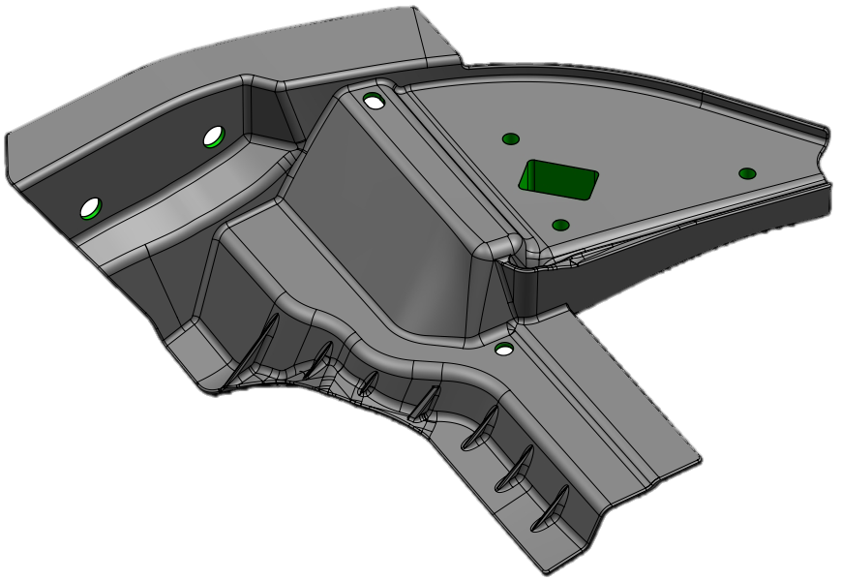

“DaeYong Industry CO.” TECHNICAL REVIEW FOR GENERAL MOTORS
Update 15.Oct.2024
Quoting Manufacturing DUNS Number(s):
RFQ #:
eSOR #:
Program:
Commodity:
Bundles:
Date:
687885681
1201092457
204203
2028 T1XX-2 SUV
REINFORCEMENT-FRT S/D INR PNL MIR
LH, RH
11-Oct-2024
GM Confidential

Slide 2
NOTE:
Please NO STATEMENTS OF SUPPLIER CONFIDENTIALITY
The Supplier MUST understand Math Models, verify GD&T, confirm ALL SOR Content & Appendices BEFORE agreeing to Tech Review date and be prepared to successfully support GM program(s) being quoted from nomination to build-out.
An electronic copy of Supplier presentation including all forms requested in SOR MUST be submitted to GM Purchasing, DRE, SQ GCL and Technical Specialist at least 48 hours in advance
(even if it is a draft copy).
It is expected that all the content in this template should be in the advanced copy. Failure to provide the advanced copy with requested content could lead to DISQUALIFICATION.
GM Confidential

Slide 3

AGENDA
Introductions / Safety / Diversity, Equity & Inclusion Message
Company Overview
Program & Product Overview
Timing & Execution Overview
Die Processing
Assembly Processing
Welding Plan
Dimensional Plan
DFMEA, PFMEA and Validation
Capacity, Operating Plan & Resource Allocation
Quality Overview & Scorecards
Commercial Overview
M7 Review
(Appendix M7 - Technical Issue List)
Assembly & welding N/A
GM Confidential

Slide 4
1. Introductions
List of Tech Review participants
Title | Name | Phone Number | E-Mail Address
Engineering General Manager | S.H. Park | +82 31 500 2845 | psh07@daeyong.co.kr
Technical Sales Sr. Manager | Chris Park | +82 31 500 2839 | kspark@daeyong.co.kr
Engineering Sr. Manager | H.W. Choi | +82 31 500 2850 | hwchoi@daeyong.co.kr
Technical Sales Manager | John Kim | +82 31 500 2858 | twkim2@daeyong.co.kr
Account Manager | Matthew Kern | +1 248 227 5511 | mkern@dyc-usa.com
Sales Engineer | Jayden Chun | +1 917 806 3636 | dchun@gkasales.com

Slide 5
2. Company Overview - Corporate structure & divisions
CEO
(Privately Owned)
TOP MANAGEMENT
IKSAN
PLANT
SIHWA
Head Quarter
VIETNAM
PLANT
PLANT DIRECTOR
FUNCTIONAL
GROUP
Manufacturing
R&D
* NBD
Sales
Admin
Finance
Manufacturing
Management
R&D 1
*NBD
Technical
Sales
HR
Accounting
R&D 2
Casting
R&D 3
Advanced development
Sales
Management
Purchasing
Machining
Production
Engineering
Inspection
Tool
Building
**S.H.E
OPERATIONAL
TEAM
Quality
*New Business Development
**Safety, Health & Environment

Slide 6
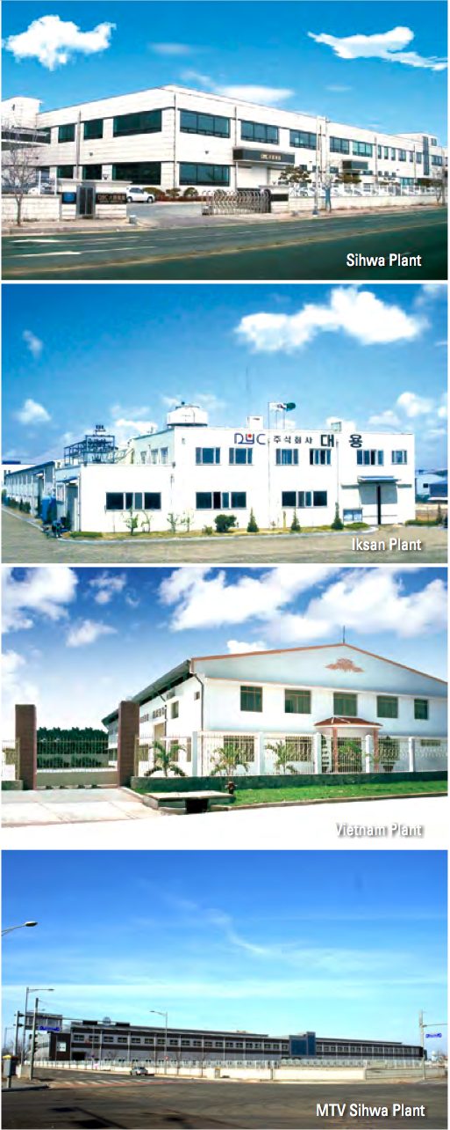

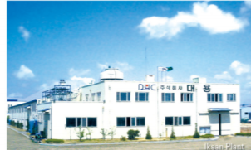
2. Company Overview - Locations
DAEYONG Plants
SIHWA Plant (HQ)
470 employees
34,014 Square meter / 32km from Seoul
(Machining, Washing, Assembly, Final Inspection, Packing, and Shipping)
MTV Plant
Completed on Oct12,2015
52,669 Square meter / 5 min from SIHWA
(Al Die casting, Trimming, Shot Blasting)
IKSAN Plant
122 employees
30,000 Square meter / 200km from Seoul
(Al Die casting, Trimming, Shot Blasting, Machining, Washing, Assembly, Final Inspection, Packing, and Shipping)
Incheon
Seoul
SIHWA & MTV
IKSAN
Busan
Jeju

Slide 7
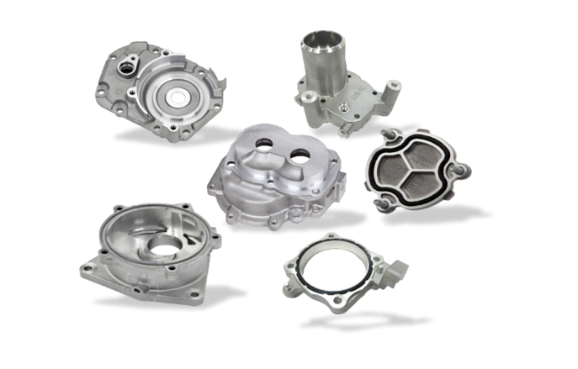

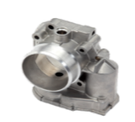
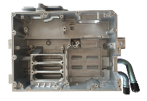
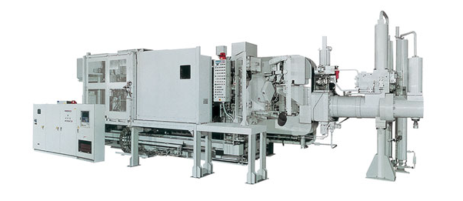
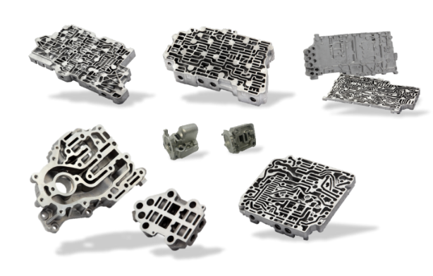

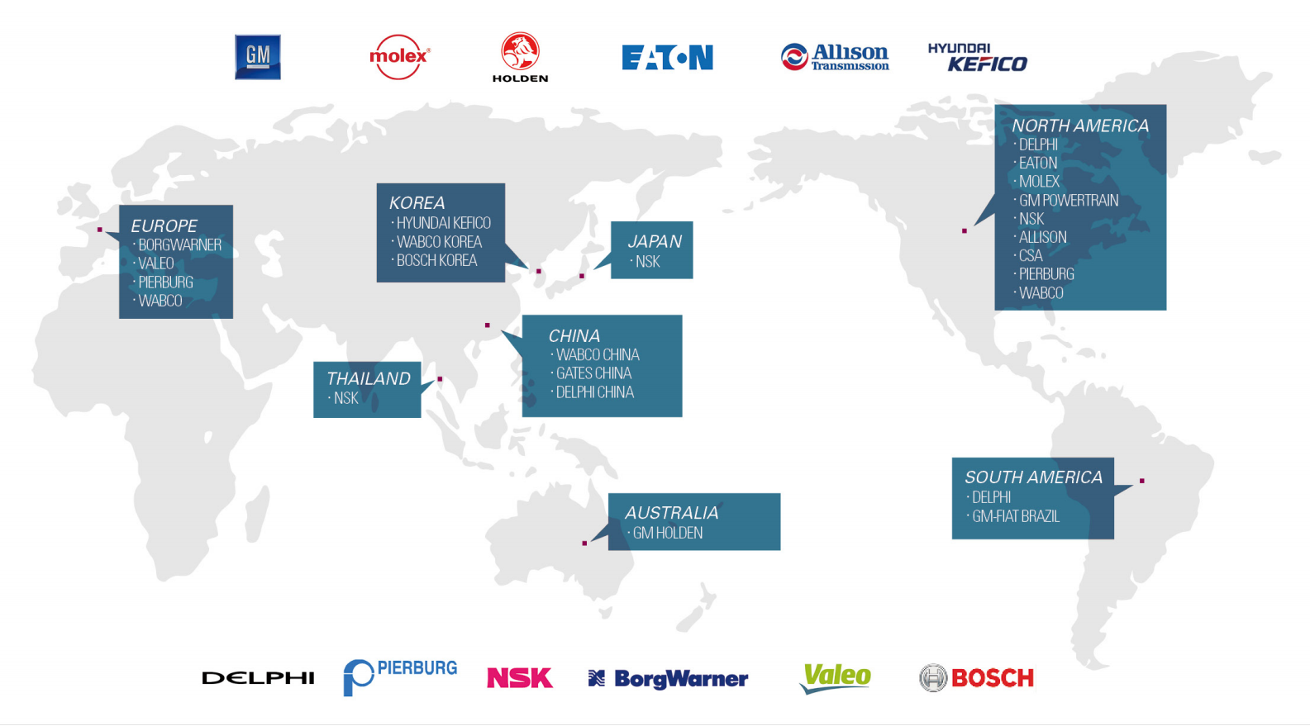

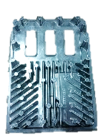

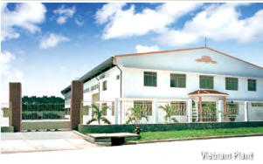


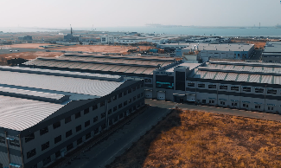



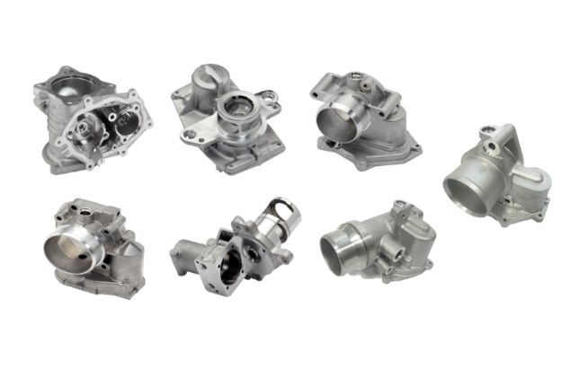
2. Company Overview - History
1993
Start
Auto Parts
(Delphi)
1999
Iksan Plant Established
Start Biz with Eaton & Molex
2004
Start Biz with BorgWarner & NSK Steering
2014
Start Biz with Hitachi USA
2020
New DCMs
1,650-ton (2 sets), 2,500-ton (1 set) setup at MTV Plant
1983
DaeYong
Established
(Lead wire)
2023
Start Biz with
Stellantis
1992
Start Aluminum
Die Casting
(HDD to Samsung)
1996
Vietnam Plant Established
2006-2008
Start Biz with Allison, Kefico, Pierburg, & Valeo
2015
Opened new MTV Plant (Sihwa)
2022
Start Biz with SLPT &KyungShin Cable
2002
Start Biz with GM

Slide 8


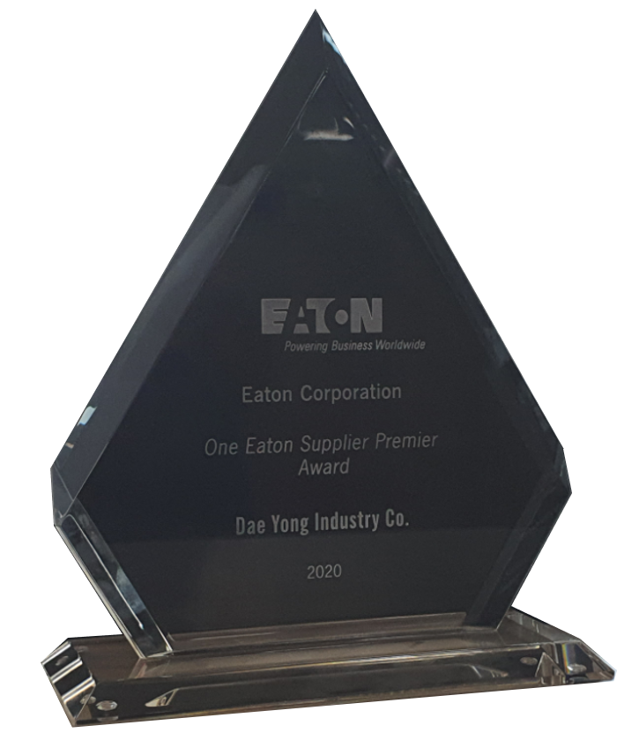
2. Company Overview - Awards from Customers
2023
GM Supplier of the Year
2022
GM Supplier of the Year
2021
GM Supplier of the Year
NSK President’s Club
2020
EATON Premier Supplier Award
GM Supplier of the Year
2019
GM Supplier Quality Excellence Award
2018
GM Supplier Quality Excellence Award
2017
GM Supplier of the Year
GM Supplier Quality Excellence Award
2015
HITACHI Development Excellence Award
NSK Supplier of the Year
2012
EATON Supplier Excellence Award
2011
EATON Premier Supplier Award
2010
WABCO Supplier Excellence for Quality Award
2009
WABCO Premier Supplier Award
2007
BORGWARNER “Zero PPM” Accomplishment Award

Slide 9














2. Company Overview - Global Customers
CHINA
〮 ZF Wabco China
NORTH AMERICA
〮 GM
〮 Allison
〮 BorgWarner
〮 Continental
〮 Cosworth
〮 CSA
〮 Eaton
〮 Hitachi
〮 Molex
〮 NSK Steering
〮 Pierburg
EUROPE
〮 BorgWarner
〮 Eaton
〮 Pierburg
〮 Valeo
〮 ZF Wabco
KOREA
〮 GM Korea
〮 Aptiv Korea
〮 ZF Wabco Korea
〮 Kyungshin Cable
THAILAND
〮 NSK Steering
SOUTH AMERICA
〮 GM Argentina
〮 GM Brazil
〮 ZF Wabco Brazil
AUSTRALIA
〮 Holden CCA

Slide 10

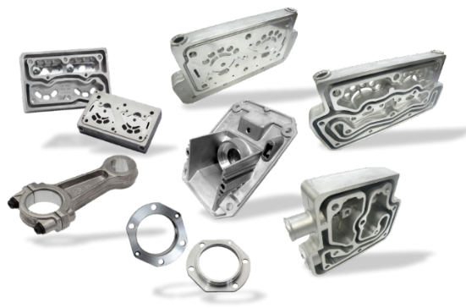
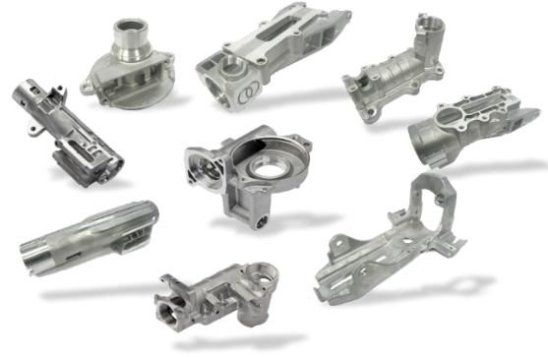
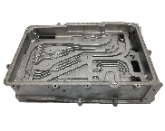
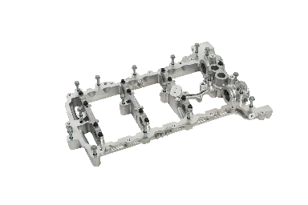
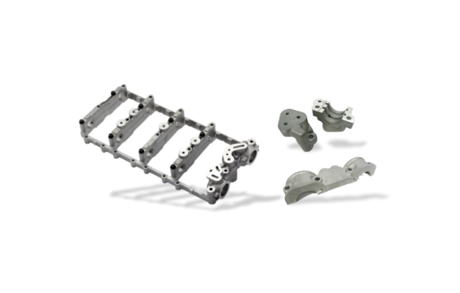




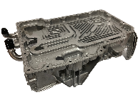


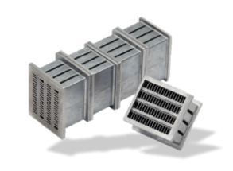
Air Compressor
EGR/ ETC ●
Steering Parts
EV Parts ●
Cam Carrier
Engine / Throttle Body /
Exhaust Gas Recirculation
Steering
Transmission
Transmission Valve Body
Super Charger / Engine parts ●
Heat Exchanger

Slide 11

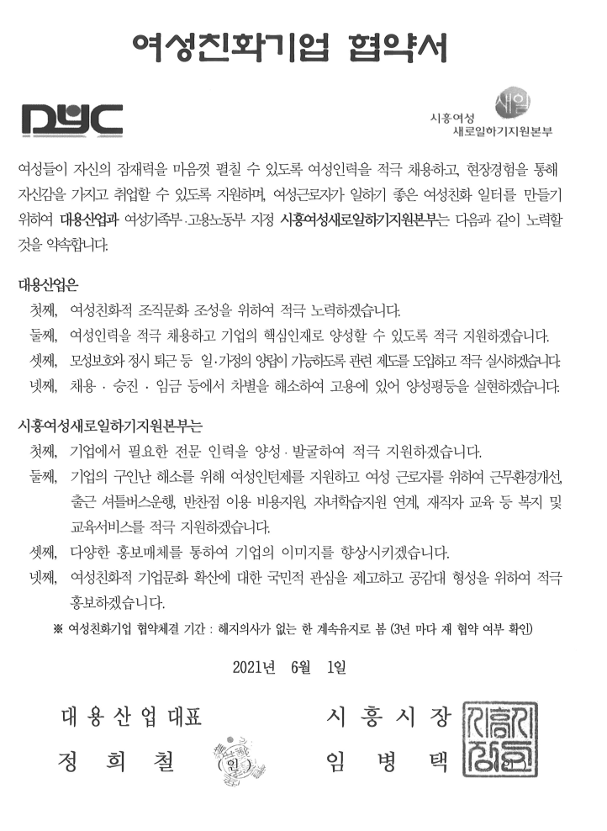
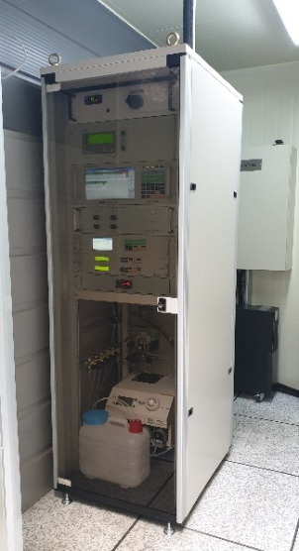
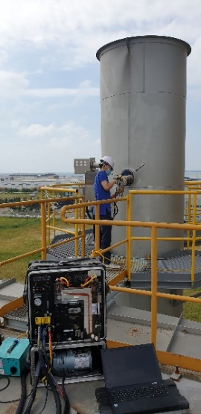

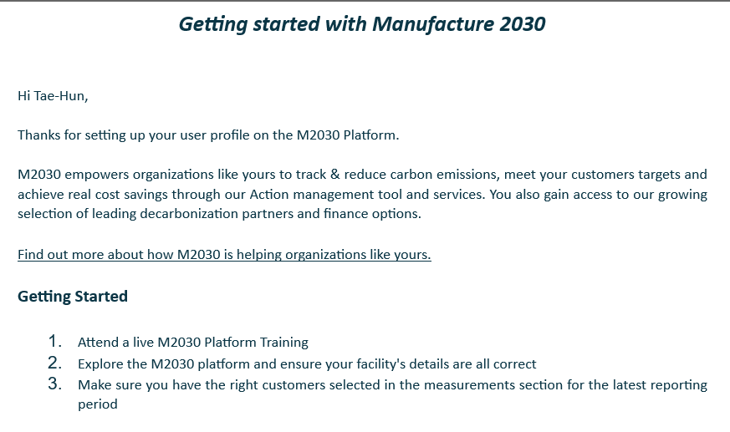
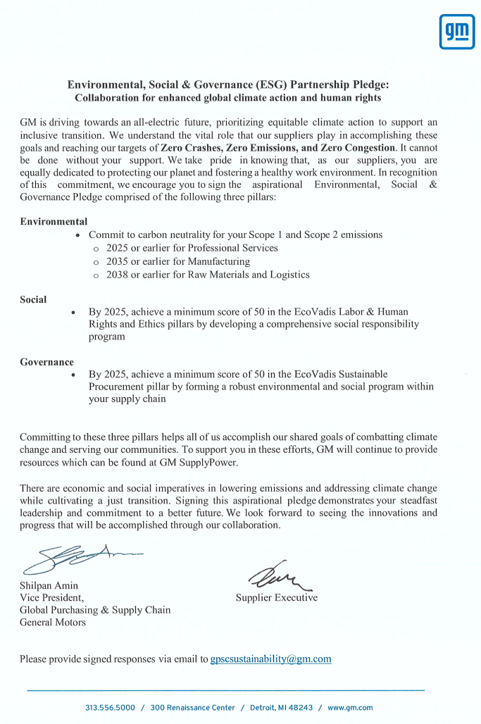
2. Company Overview– ESG(Environment・Social・Governance)
Installed TMS equipment (chimney automation measurement monitoring equipment) on the melting facility dust collector.
Nitrogen oxide and dust discharge concentrations are being measured and analyzed every 10 seconds to keep them lower than the law regulations on atmospheric-related legal discharge concentrations.
For accurate measurement of TMS, specialized company do management for it, regularly conduct maintenance every month.
M2030 Platform
DaeYong joined the platform in April 2024.
Low carbon manufacturing Program.
Realizing gender equality through the 'Women-Friendly Company Agreement' with Siheung City(Local Government) by actively hiring women and forming a women-friendly organizational culture.
ESG pledge signed around Feb,2022

Slide 12
2. Company Overview - Commercial Overview of Company
DaeYong Business Plan - Key Technologies and Future Strategy
High Quality Aluminum Die Casting and Machining, Complicated mold structures such as valve bodies
High vacuum casting system, weldable and improved mechanical property on casting parts (High Integrity Die Castings)
Focus on EV components such as Inverter Case / Motor Housing / Structural Parts
Invest further for larger Die casting machines(2,500 and 1,650ton) and related parts : LCE (lower crank extension), Oil pan, Engine Cover, Inverter case, EV motor case and Structural parts
Expand with additional factory in North America →US or Mexico
Additional Investment in automation
Support existing Engine and Transmission business

Slide 13
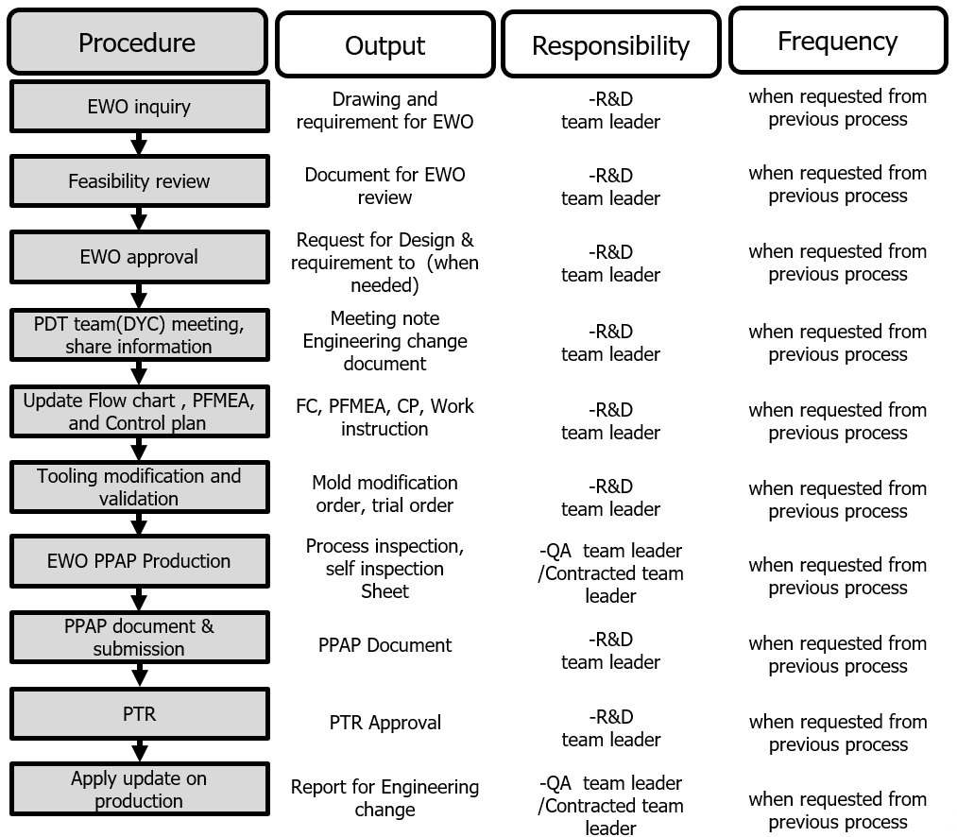
2. Company Overview– Organizational Capabilities & Technical Capabilities
Program management and change management system
Technical Capabilities
* Currently using UG, GM Tool kit - NX 2206 platform
* Parts Development Tools: 3D Printer, CT Scan, etc.
* Functional and Developmental Testing
- Porosity measurement equipment, and software that is the same as GM uses
- Sediment, particle control

Slide 14
2. Company Overview– Continuous Improvement
Investment in Production technology and equipment as a % of sales in 2023: About 10.65%
 | Amount | Details
Sales | $ 100M | SIHWA+IKSAN plants
Investments | $ 10,650,000 | Production technology and Equipment: $10,650,000 (10.65% of sales)

Slide 15
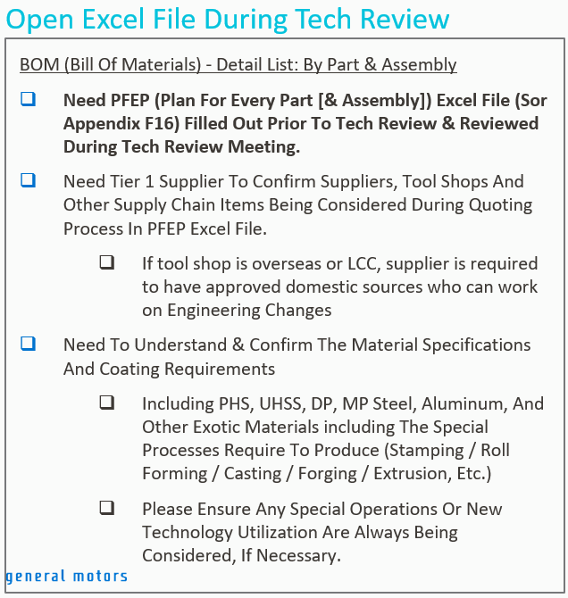
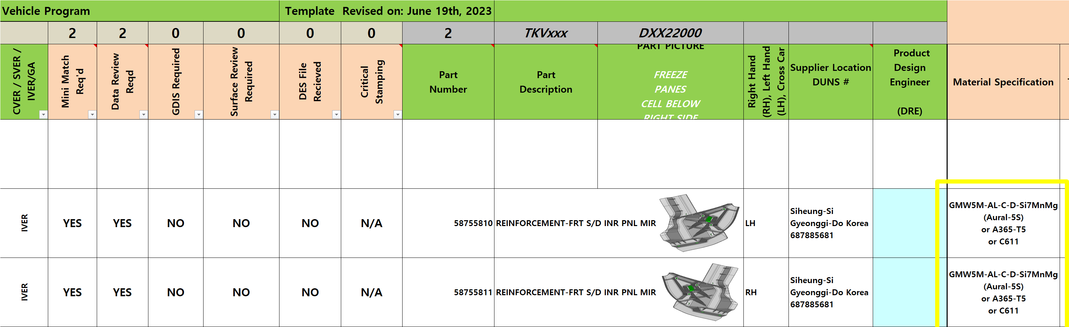
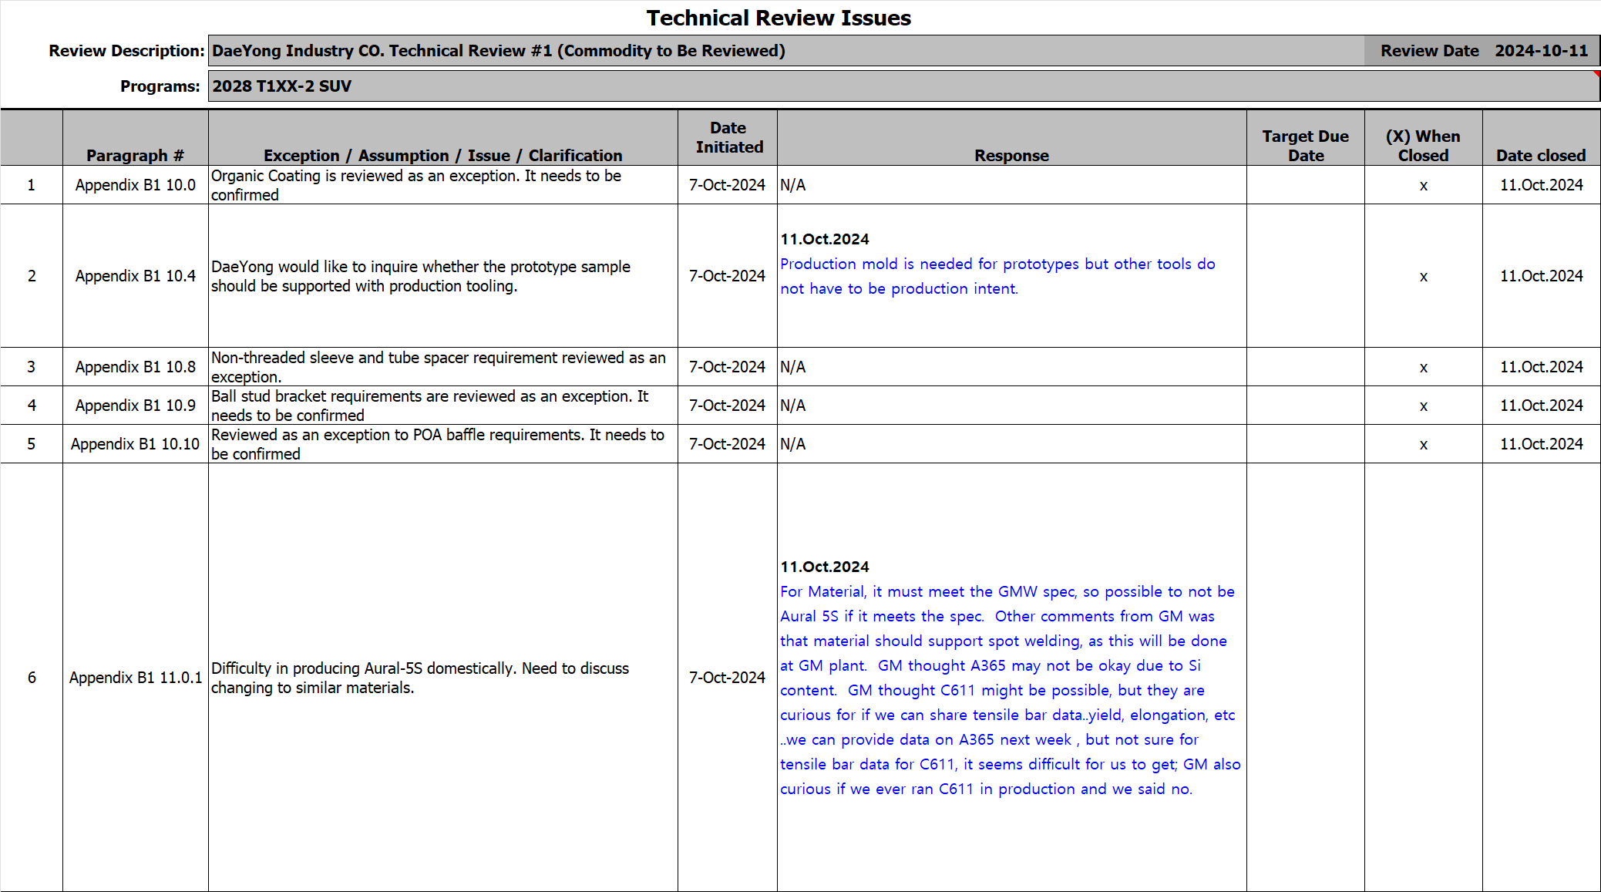
PROGRAM & PRODUCT OVERVIEW
Update 15.Oct.2024
Update 15.Oct.2024
Update 15.Oct.2024
GM Confidential

Slide 16
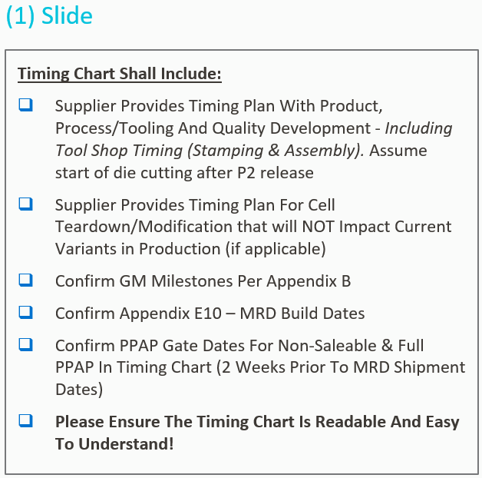
TIMING & EXECUTION OVERVIEW
Update 15.Oct.2024
Update 15.Oct.2024
Tooling Timing (Mold, Fixture, Gage)
Embedded file
for reference
Facilities Timing (X-ray, FPI, Washing)
1.May.2026
TKO(expected) [D-day]
10.Apr.2026
TKO(expected) [D-day]
28.Aug.2026
Tool build [D+17w]
24.Apr.2026
Decision on equipment[D+2w]
18.Sep.2026
Tool verification [D+19w]
23.Oct.2026
Equipment build [D+28w]
25.Sep.2026
PPQP Submit [D+21w]
06.Nov.2026
Trial runout [D+30w]
16.Oct.2026
Mini-Match [D+24w]
27.Nov.2026
NS-PPAP [D+33w]
13.Nov.2026
Matching [D+28w]
05.Feb.2027
PPAP [D+43w]
27.Nov.2026
NS-PPAP [D+30w]
10.Jan.2028
SORP [D+92w]
11.Dec.2026
MRD APPV [D+32w]
05.Feb.2027
PPAP [D+40w]
19.Feb.2027
MRD PPV [D+42w]
18.Jun.2027
MRD NS1.0 [D+59w]
30.Jul.2027
MRD NS2.0 [D+65w]
24.Sep.2027
MRD S1.0 [D+73w]
10.Jan.2028
SORP [D+89w]
GM Confidential

Slide 17
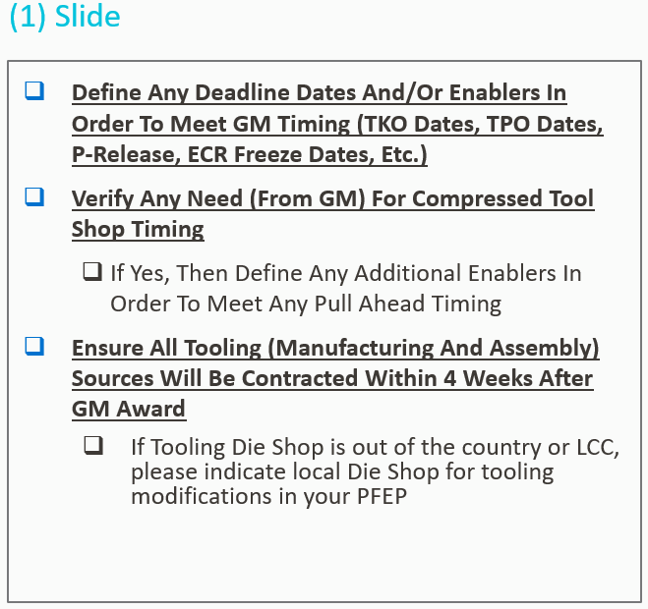
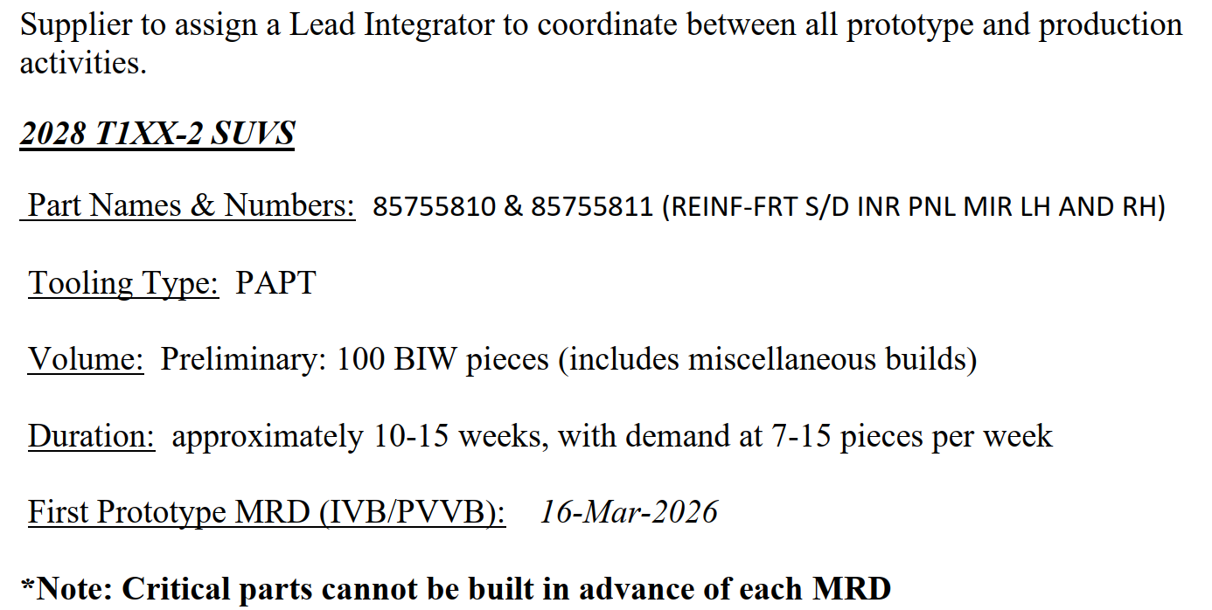
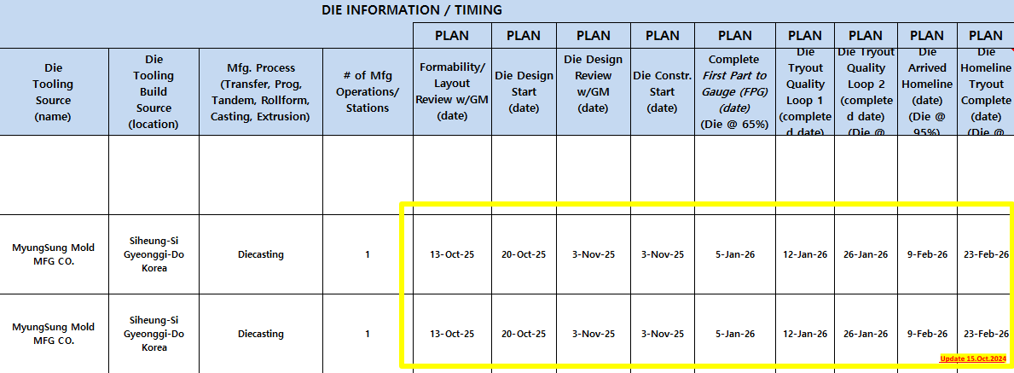
TIMING & EXECUTION OVERVIEW
Update 15.Oct.2024
Prototype Timing (100 pcs)
Appendix B – Prototype MRD
20.Oct.2025
TKO [D-day]
03.Nov.2025
Mold Design Feview [D+2w]
05.Jan.2026
Mold Build [D+11w]
16.Feb.2026
Tool Validation [D+17w]
23.Feb.2026
PPQP Submit [D+18w]
02.Mar.2026
First Shipping(15pcs) [D+19w]
16.Mar.2026
Prototype MRD [D+21w]
Update 15.Oct.2024
GM Confidential

Slide 18
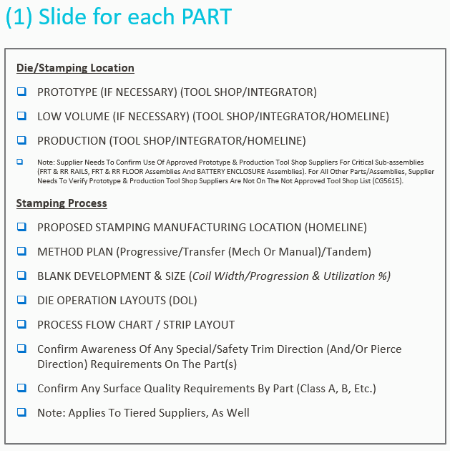
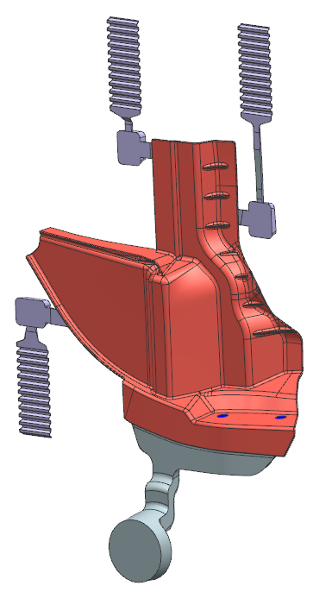
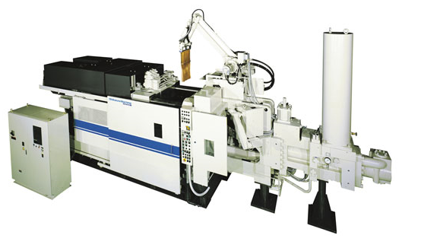
DIE PROCESSING
Chill Vent (optional: vacuum)
Overflow
Dicasting Machine
Cavity
Runner
Machine class: 800ton Super High-speed
Die casting (SHIBAURA)
Mold Material: S45C(Mold base), SKD61(Core)
Biscuit
GM Confidential

Slide 19
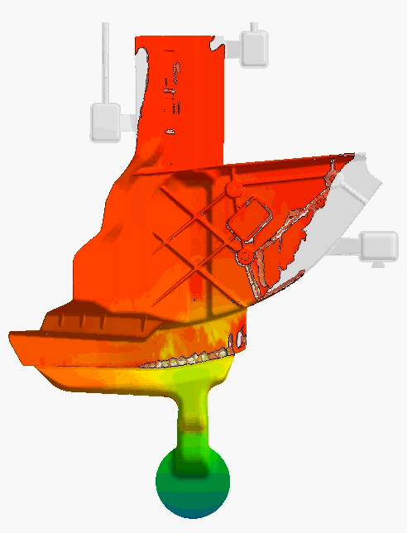
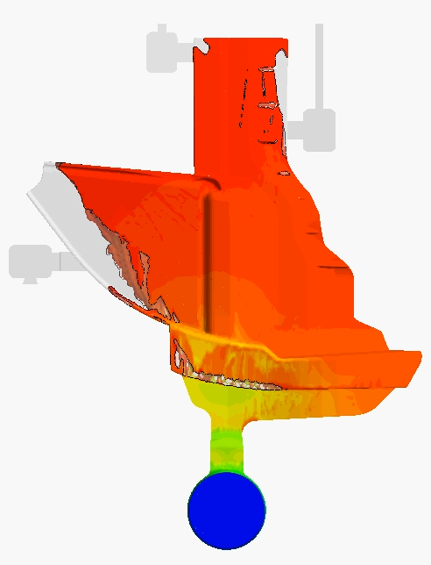
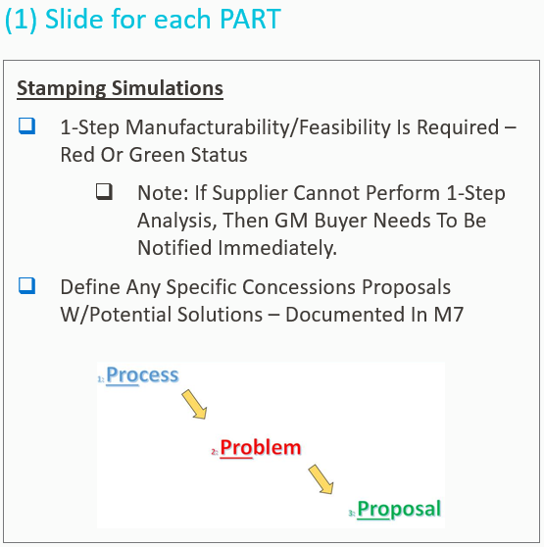
DIE PROCESSING
Analysis of
Flow Pattern
Movie file
Click to play
Movie file
Click to play
Moving side
Fixed side
Flow Pattern Analysis Result :
The part is thin and complex, so the conditions were set to be filled quickly and in a short time, and the fan shape shows an even distribution that is filled in a balanced manner. There is no problem with flow analysis.
The overflow is properly located at the final filling area, so the possibility of defects caused by gas isolation is low.
If gas isolation is a problem in the actual part, there is room for improvement through vacuum application.
GM Confidential

Slide 20
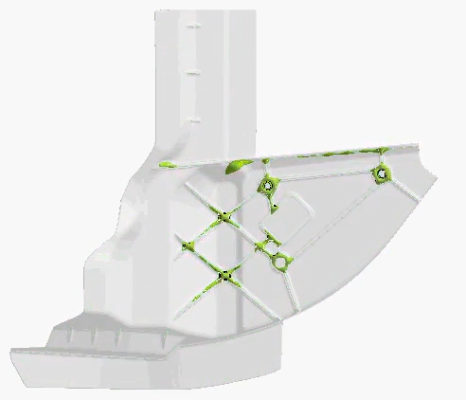
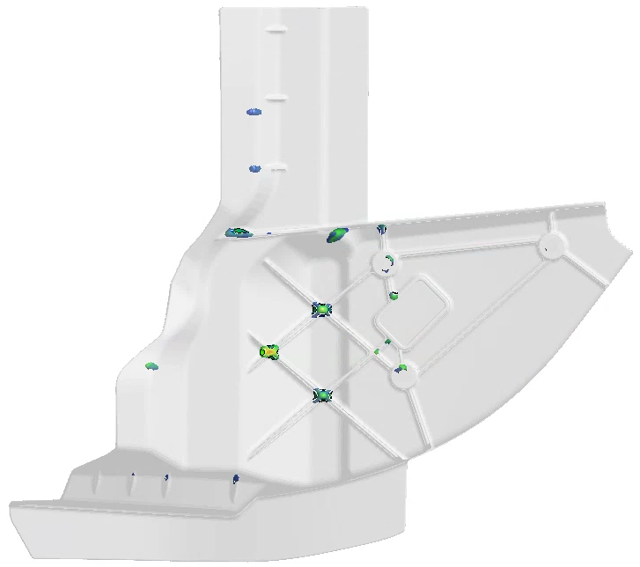
DIE PROCESSING
The patterns mean possibility to occur shrinkage, not porosity size.
Solidification
Analysis Movie
Shrinkage Pattern
Analysis
Movie file
Click to play
Solidification Analysis Result :
Because the part is thin, final solidification occurs at the point where the relatively thick ribs meet. However, because the thickness is thin, the shrinkage volume is small, so the possibility of defects occurring as solidification progresses is low.
Shrinkage Analysis Result :
Since the part is thin, the shrinkage pattern is evenly distributed, and the pattern size is small, the possibility of defects due to shrinkage is low.
GM Confidential

Slide 21
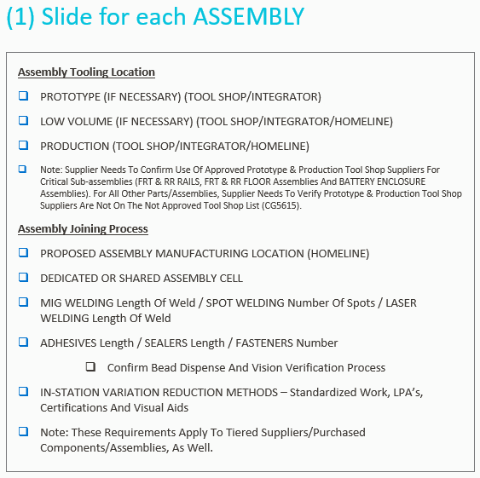
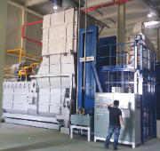
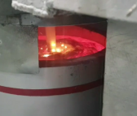
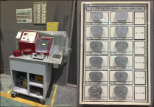

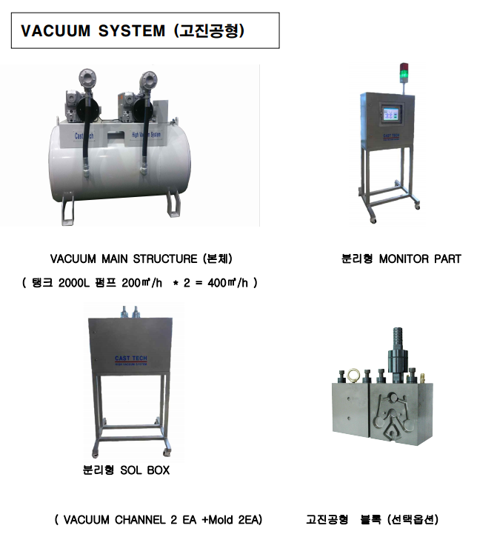

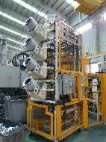
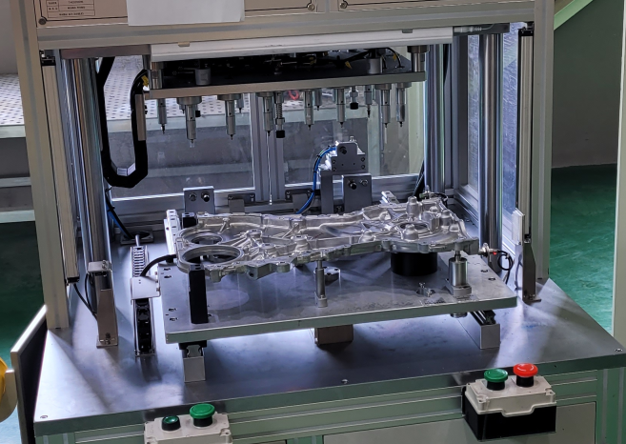





ASSEMBLY PROCESSING
Reference : The part does not require assembly.
10. Melting
Tilting Furnace
G.B.F
Density Index
20. HIDC & Trimming
HPDC Machine (automation)
Vacuum
Air Cooling
Trimming
Update 15.Oct.2024
30. Straightening
(After checking the actual sample, follow up discussion will be made)
straightening tester
Profile measurement
50. X-ray, FPI Inspection
Moving
X-ray Inspection
GM Confidential
FPI Inspection

Slide 22








ASSEMBLY PROCESSING
Reference : The part does not require assembly.
60. Machining
Machining Fixture
Machining Center Line
70. Washing & Dry
Washing & Dry Machine
80. Final Inspection
Final Inspection
85. E.P.C
90. Packing & Shipping
GM Confidential
Packing
Shipping

Slide 23





DIMENSIONAL PLAN
SAMPLE
Gages
Limit, Functional
Dial, Digital types
100% full measurement review only for critical characteristics and process capability insufficient items in accordance with 2D drawing requirements.
Sampling cycle and quantity will be set according to other tolerance characteristics.
(it can be planned after 2D drawing received.)
GM Confidential

Slide 24





DIMENSIONAL PLAN
SAMPLE
SAMPLE
SAMPLE
SAMPLE
Minitab
Process Capability
Sixpack Report
Excel sheet
Process Capability
X-mR chart
Using Minitab & Excel to manage process capability and analyze cumulative data.
Record and analyze casting data through smart factory system.
Monitor mold schedule, approval, lifespan, etc. through mold management system.
GM Confidential

Slide 25



DFMEA, PFMEA AND VALIDATION
Starting from DFMEA Review,
PFMEA , Gap Audit to be done
SAMPLE
They will be arranged after receiving
DFMEA & Milestone info
Schedule management based on APQP Timing Chart
GM Confidential

Slide 26


CAPACITY, OPERATING PLAN & RESOURCE ALLOCATION
N/A
Appendix B1
IVER MRD Quantities (Appendix E10)
Qty Date Program Milestone
?? pcs 16.Oct.2026 T1UXF, T1YXF Mini Match
30.Oct.2026 PPQP Approval
40 pcs 13.Nov.2026 T1UXF, T1YXF Matching
27.Nov.2026 NS-PPAP Approval
60 pcs 11.Dec.2026 T1UXF, T1YXF APPV
?? pcs 11.Dec.2026 T1ULF, T1YLF Mini Match
40 pcs 08.Jan.2027 T1ULF, T1YLF Matching
60 pcs 05.Feb.2027 T1ULF, T1YLF APPV
05.Feb.2027 PPAP Approval
90 pcs 19.Feb.2027 T1UXF, T1YXF PPV
90 pcs 16.Apr.2027 T1ULF, T1YLF PPV
90 pcs 18.Jun.2027 T1UXF, T1YXF NS1.0
90 pcs 30.Jul.2027 T1UXF, T1YXF NS2.0
90 pcs 13.Aug.2027 T1ULF, T1YLF NS1.0
13.Aug.2027 Run at Rate Complete
90 pcs 24.Sep.2027 T1ULF, T1YLF NS2.0
?? pcs 24.Sep.2027 T1UXF, T1YXF S1.0
04.Oct.2027 DaeYong SORP
?? pcs 19.Nov.2027 T1ULF, T1YLF S1.0
10.Jan.2028 T1UXF, T1YXF SORP
06.Mar.2028 T1ULF, T1YLF SORP
GM Confidential

Slide 27


CAPACITY, OPERATING PLAN & RESOURCE ALLOCATION
Update 15.Oct.2024
GM Confidential

Slide 28

11. Quality Data- PFMEA (Example)
EXAMPLE
28

Slide 29

11. Quality Data- Control Plan (Example)
EXAMPLE
29

Slide 30




11. Quality - Testing/Validation facilities and capabilities
Density Index
Inspector name
Frequency: 2times/Shift
Day1
Day2
The amount of gas in molten metal to be measured and managed.
Night 1
Night 2
Manufacturer : mk -GmbH
Model name : ALSP plus DT
Spectrometer
Chemical Composition Analysis to be completed during the day/night
Frequency: 1time/Shift
The components of ingot and molten metal to be analyzed and managed.
Day
Night
Manufacturer : ALDCA
Model name : KA-383

Slide 31



11. Quality - Testing/Validation facilities and capabilities
Component Cleanliness Cabinet
(To collect particle)
Particle Measurement :
Size, Weight, Quantity
Particle Measurement Equipment
Drying
machine
Video
Microscope
system
Micro-
scope
SAMPLE
Magnifier
Micro-
balance
Manufacturer : Motic
Model name : SMZ168
X 100 scale
Manufacturer : PALL
Model name : Component Cleanliness Cabinet
Manufacturer : Sometech
Model name : SV-35 X 300 scale

Slide 32




11. Quality - Testing/Validation facilities and capabilities
Universal Test Machine
Rockwell
Hardness Tester
Brinell
Hardness Tester
SAMPLE
-Tensile Strength
-Yield Strength
-Elongation
-3 Point Break Strength
Manufacturer : Daekyoung Tech
Model name : DTR-200
Capacity : 150kgf
Manufacturer : KSTM
Model name : K-SHB-100
Capacity : 3,000kg
Manufacturer : DaekyoungTech
Model name : DTU-900MH 10T

Slide 33




11. Quality - Testing/Validation facilities and capabilities
CT Scanner
CT Scan Analysis Movie
SAMPLE
3D
2D
X-ray Energy: 10kV~190kV
Detector Type : Flat Panel(DDA)
Detector Size : 400 x 400 mm
Sample Weight : 227 kg max.
Focal Spot Size : 500nm min.
Manufacturer : NSI
Model name : X5000
Power : Max. 320W
For Inner porosity, Visualization analysis Movie
SAMPLE
CT Result Analysis
Before
After
-Porosity rate, Defect size, Reverse engineering rendering
-Satisfy ASTM-E2339, E2669, E2738, E2767 specifications

Slide 34

COMMERCIAL OVERVIEW
Update 15.Oct.2024
Prototype - Lead Time
No. | Description | Lead Time | Remark
1 | Tooling Build | 13 weeks | Die-casting: In house Dimension check: By CMM The Lead time is from receipt of PO with 2D&3D. First Sample qty 15 pcs base(based on SOR Appendix B) Manual : Washing, X-ray, FPI
2 | Tooling Verification | 17 weeks
3 | Sample Production | 18 weeks
4 | Sample shipping | 19 weeks
Prototype – Tooling Lead Time Detail
Tooling | Lead Time | Quantity (set/each)
Die-Cast Mold | 11 weeks | 1
Machining Fixture | 13 weeks | 1
Tooling Total | 13 weeks | 2
(Reference) Appendix B
First Prototype MRD : 16.Mar.2026
Diecasting Mold & Machining Fixture is based for production, so they can be utilized for serial production
Update 15.Oct.2024
Matching MRD - Lead Time
No. | Description | Lead Time | Remark
1 | Tooling Build | 17 weeks | Die-casting: In house Dimension check: By CMM, Gages The Lead time is from receipt of PO with 2D&3D. Sample qty 20 pcs base(based on SOR Appendix E10) Manual : Washing, X-ray, FPI
2 | Tooling Verification | 19 weeks
3 | Sample Production | 21 weeks
4 | Sample shipping | 22 weeks
Matching MRD – Tooling Lead Time Detail
Tooling | Lead Time | Quantity (set/each)
Trimming | 14 weeks | 1
Gage | 17 weeks | 1
Tooling Total | 17 weeks | 2
(Reference) Appendix E10
Matching MRD : 11.Dec.2026
Trimming & Gage is based for production, so they can be utilized for serial production
GM Confidential

Slide 35

M7 REVIEW
GM Confidential

Slide 36



IMPORTANT TECH REVIEW ITEMS
Required material : Aural-5S-F
Tensile Mechanical Properties
wt(%)
Si | Fe | Cu | Mn | Mg | Zn | Ti | Ni | Sn | Sr | P | Others (Each) | Others (Total) | Al
9.5~ 11.5 | 0.15 Max. | 0.03 Max. | 0.5~ 0.8 | 0.1~ 0.5 | 0.07 Max. | 0.04~ 0.15 | - | - | 0.005 ~0.015 | 0.001 Max. | 0.03 Max | 0.10 Max | Remainder
A365
Quoted material in Round 1
Update 15.Oct.2024
Sample Info. | Spec. | A365-F | A365-T5 #1 | A365-T5 #2 | A365-T5 #3 | A365-T5 #4 | A365-T5 #5
Ultimate Tensile Strength | 240 MPa min | 295 MPa | 308 MPa | 306 MPa | 302 MPa | 304 MPa | 297 MPa
Yield Strength (0.2% offset) | 100 MPa min | 149 MPa | 192 MPa | 187 MPa | 188 MPa | 188 MPa | 182 MPa
Percent Total Elongation | 5 % min | 7 % | 5 % | 5 % | 6 % | 6 % | 5 %
A365 Tensile Mechanical Properties
Test Results (by DaeYong)

Slide 37


IMPORTANT TECH REVIEW ITEMS
Required material : Aural-5S-F
Tensile Mechanical Properties
C611
or C611
considered
Update 15.Oct.2024
Test info not provided from supplier/
It is very challenging for us to test due to
Expensive cost.
First, we would like to share the info
searched on the internet.
GM Confidential

Slide 38
Commodity Specific Slides
(Only Use for Parts/Material that apply to SOR)
GM Confidential

Slide 39





EXTRUSION PARTS
Location | Prototype | Low Volume | Production
Tool Shop
Integrator
Homeline | X | X | X
Process Flow
PFMEA
Contro Plan
GM Confidential

Slide 40


EXTRUSION PARTS

Slide 41






2. Company Overview - Similar products currently producing
PN.: Part Name: | 12680230 CARRIER-CM/SHF (RH)
Material: | ALDC12
PPM: | 2023yr : 0ppm
Contracted period | Y2012 ~ 2025
PN.: Part Name: | 12694951 CARRIER-CM/SHF (LH)
Material: | ALDC12
PPM: | 2023yr : 0ppm
Contracted period | Y2017 ~ 2019
PN.: Part Name: | GD500883 CASE SUB ASSEMBLY
Material: | ALDC12
PPM: | 2023yr : 9ppm
Contracted period | Y2020 ~ 2026
PN.: Part Name: | 12680229 CARRIER-CM/SHF (LH)
Material: | ALDC12
PPM: | 2023yr : 0ppm
Contracted period | Y2012 ~ 2025
PN.: Part Name: | 12694956 CARRIER-CM/SHF (RH)
Material: | ALDC12
PPM: | 2023yr : 0ppm
Contracted period | Y2017 ~ 2019
PN.: Part Name: | GD500929 CASE SUB ASSEMBLY
Material: | ALDC12
PPM: | 2023yr : 0ppm
Contracted period | Y2020 ~ 2026

Slide 42

2. Company Overview– SSE Supplier Dashboard

Slide 43

11. Quality- Quality Metrics
  ▣ Sourceability Report Red-Yellow-Green chart status

Slide 44

11. Quality- Quality Metrics
  ▣ 9 – Panel Report
1) Nov. 8rd, 2023: Quality SPPS 165745
Missing material on PN#24246446.
2) Mar. 21th, 2024: Line Accumulation SPPS 179695
K-Hole Burr on PN#24047050.
3) Jun. 26th, 2024: Line Accumulation SPPS 190751
Porosity on PN#24047050.

Slide 45


11. Quality- Quality Metrics
  ▣ PPM internal & external per year for the last 5 year (Only for Gen2 Cam Carrier)
▣ GM Gen2 Cam Carrier Part Number: (LH Assy)12680229, (RH Assy)12680230
▣ External PPM based on Problem Case (Gen2 Cam Carrier) :
Y2020 Issue: SPPS 34758 / PN: 12680230 / Issue : Label Miss / Rejected Q’ty : 1 pallet (36pcs)

Slide 46


11. Quality- Quality Metrics
  ▣ PPM internal & external per year for the last 5 year (Only for Gen6 Cam Carrier)
▣ GM Gen2 Cam Carrier Part Number: (LH Assy)12694951, (RH Assy)12694956

Slide 47
Thank You!
GM Confidential

